Slide 1
Lunar Extraction
for
Extraterrestrial Prospecting

Slide 3
FROM THE MOON TO MARS
IN ONE
LIFETIME
Notes:
I want to start in the year . Someone 1964
Key technologies:
Transportation: heavy launch capability, large cargo, deep space navigation and communication
Working in Space: autonomous operation, in-situ resource utilization

Slide 4
LEEP is the Bridge Between Science Fiction and Science
LEEP is the right platform to accomplish Proving Ground Technology Objectives:
- Transportation: heavy launch capability, large cargo, deep space navigation and communication
- Working in Space: autonomous operation, in-situ resource utilization
Test autonomy without light time (if you want) and long-term potential recovery capability
Fundamental platform for next stage of deep space exploration and a fuel-as-a-service industry

Slide 5
Benefits of LEEP
Deep space exploration
Open the universe to human kind
Build partnerships

Slide 6
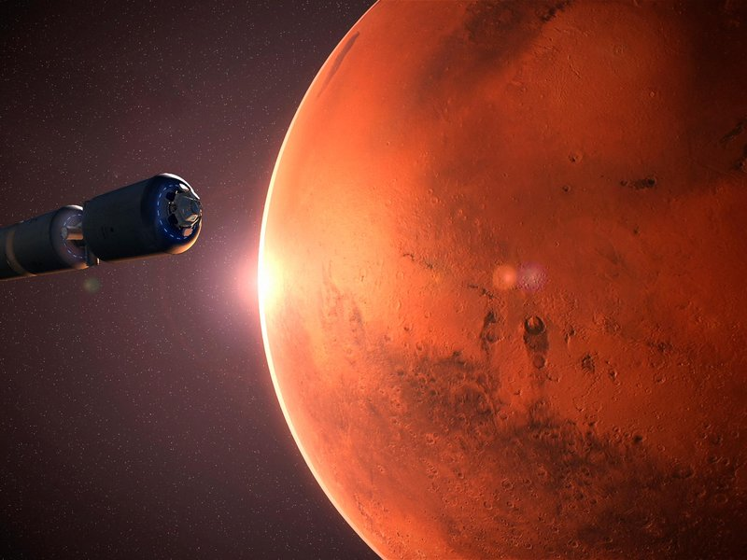
What is the mission?
In-space refueling of vehicle

Slide 7
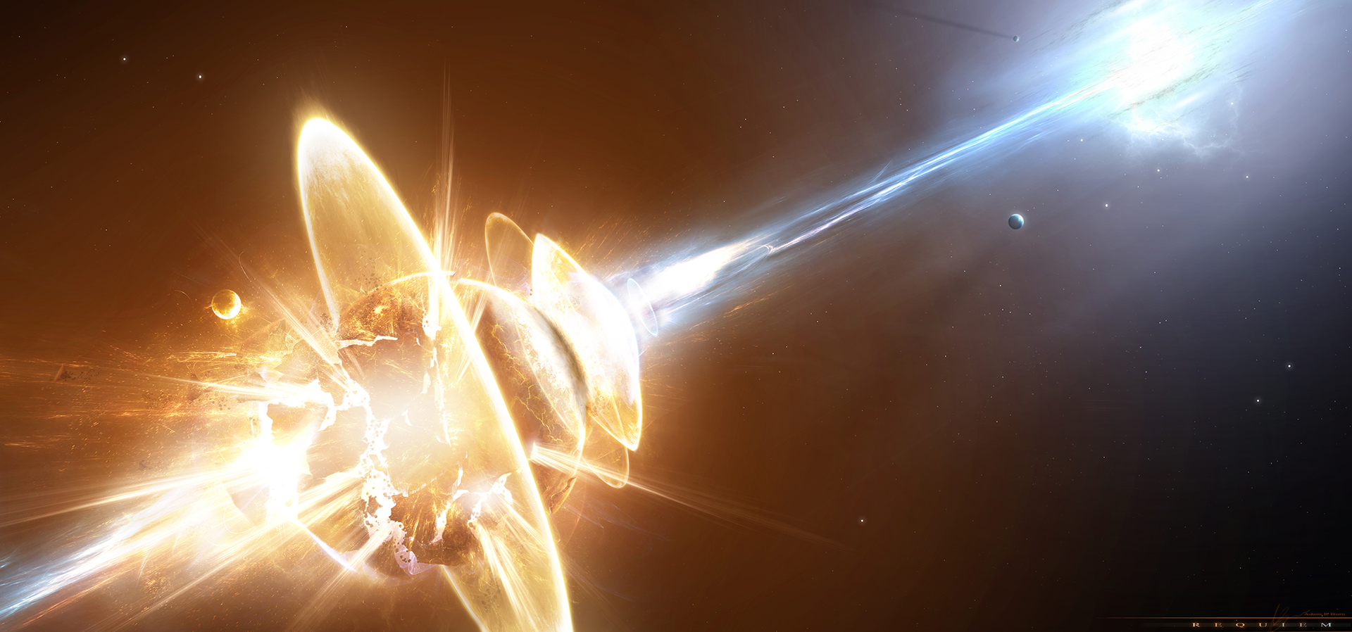
Risks
Crash Rendezvous
Single point of failure
Failed Landing

Slide 8
Develop for Success
Feasible
Profitable
Desirable

Slide 9
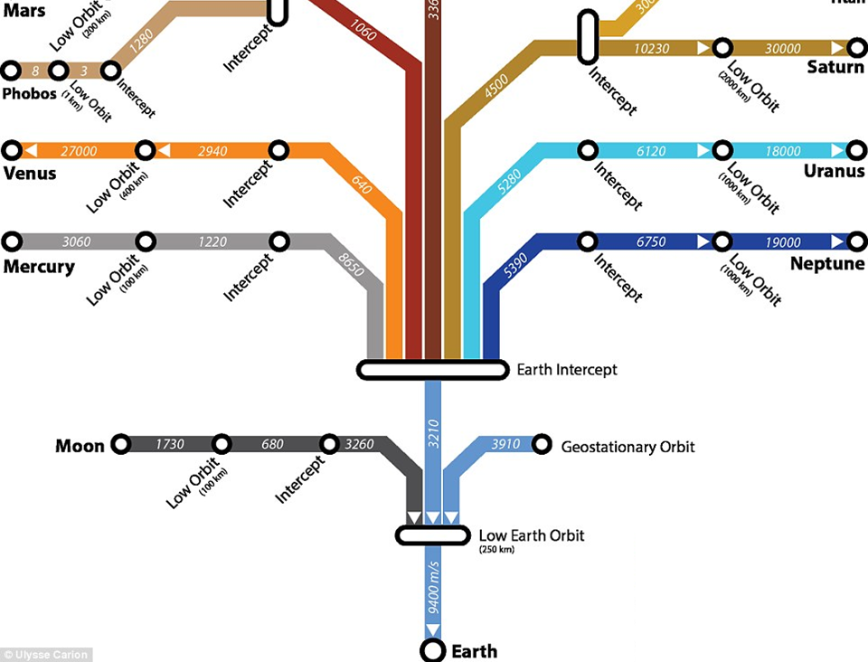
Construct for Success

Slide 10
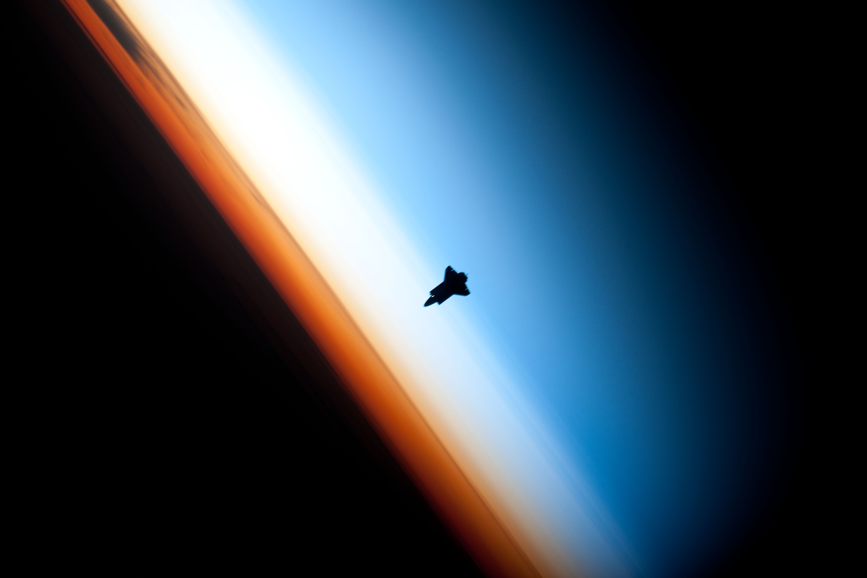
Options
Rendezvous
Location of transfer method:
- Lunarport
- Conversion
- Storage
- Power
Resource Transfer to Orbit

Slide 11
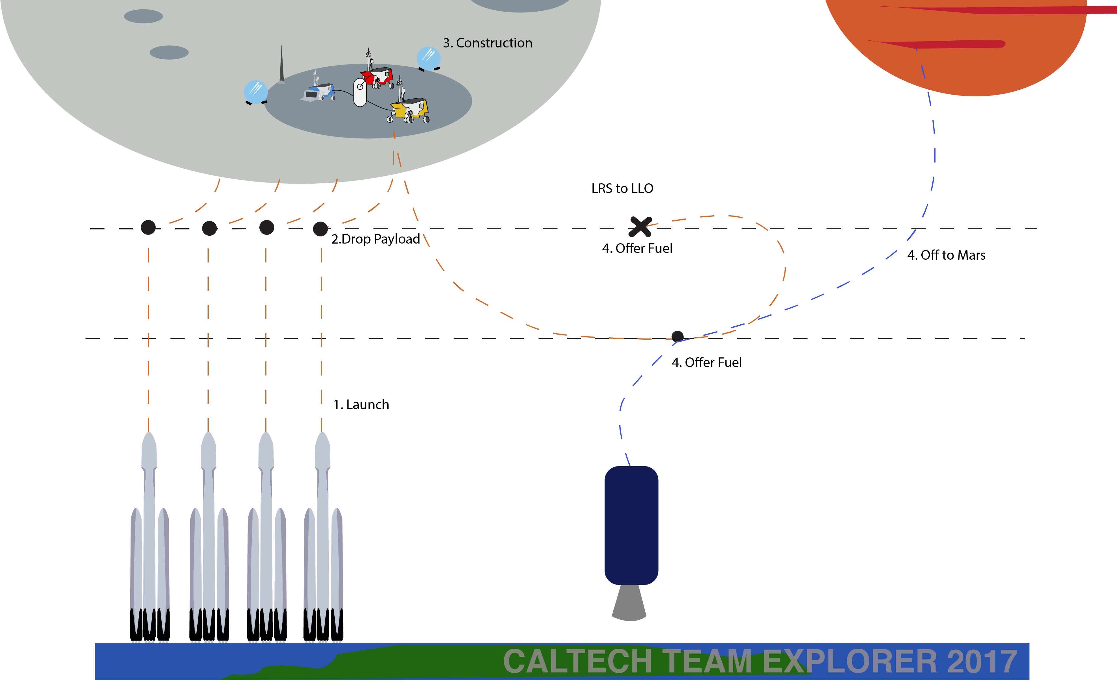
Concept of Operations

Slide 12
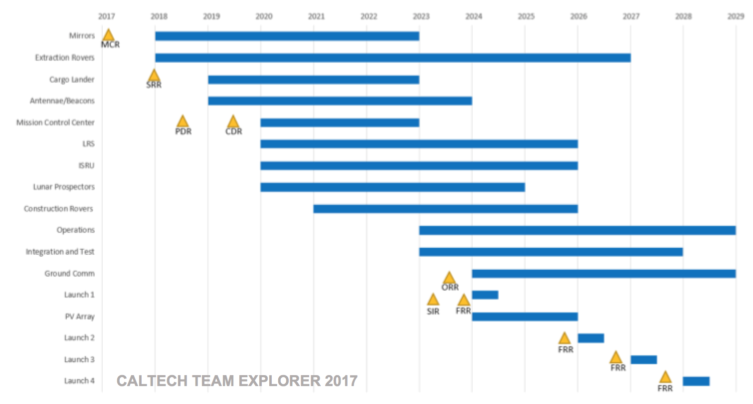
Schedule
CALTECH TEAM EXPLORER 2017

Slide 13
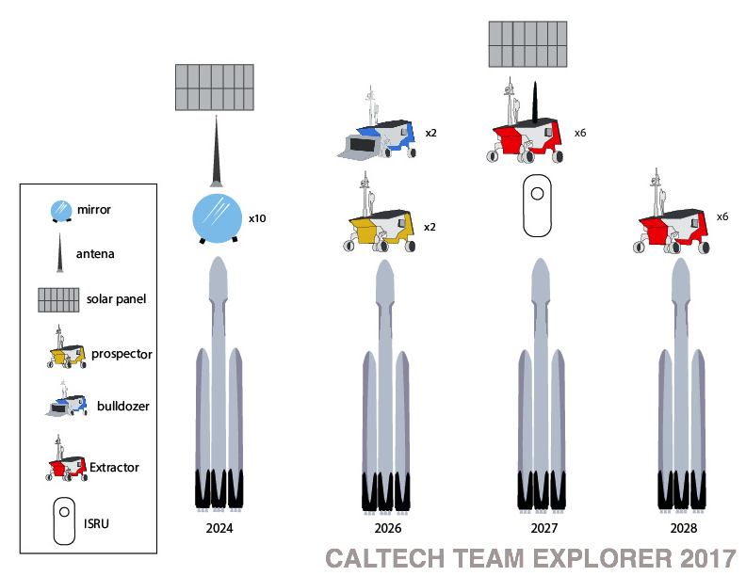
Launch Phase

Slide 14
Launch Phase

Slide 15
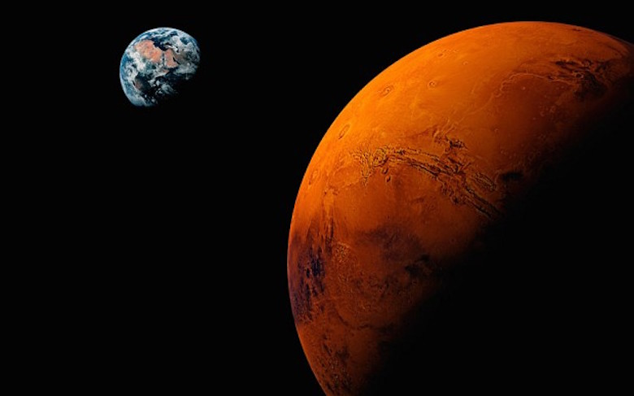
Missions to Mars by 2031

Slide 16
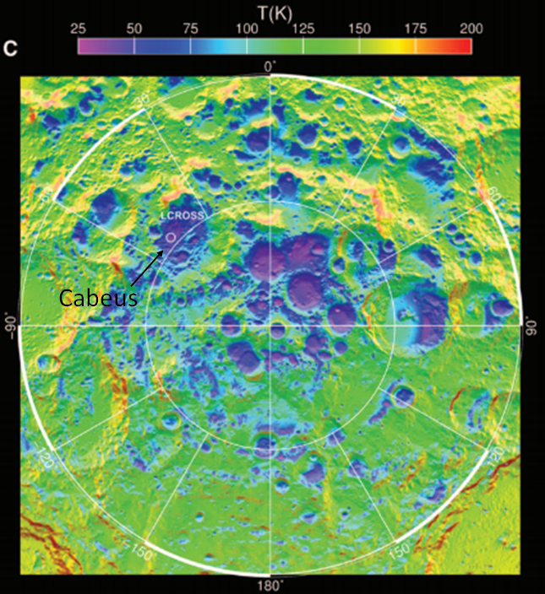
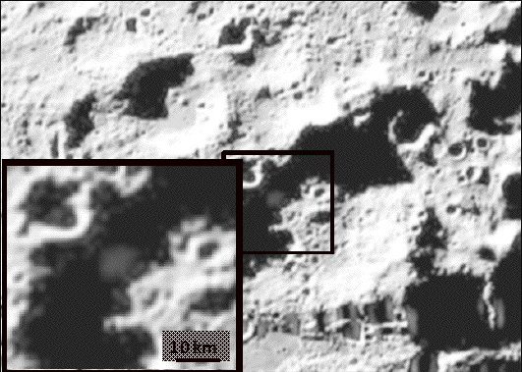
Site Selection: Cabeus Crater
NASA
Cabeus: the only Lunar location with verified H₂O in minable quantities
Paige+ 2010

Slide 17
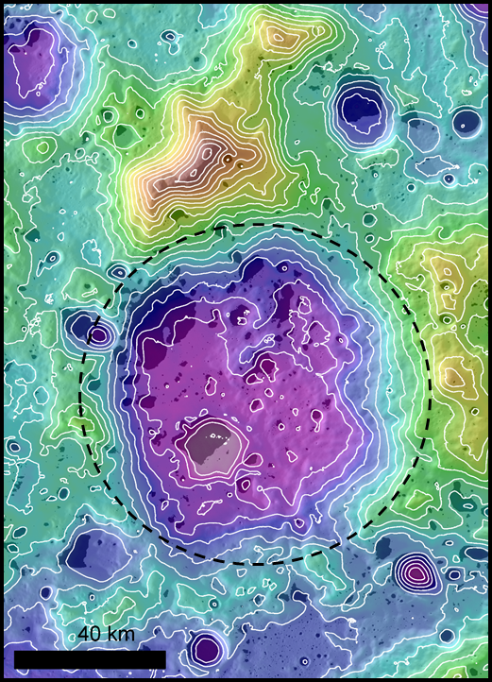
Site Selection: Where in Cabeus Crater?
Water
Power
Communications
Flat
Cabeus crater, 500 m contours
Elevation: -4 -> +4 km

Slide 18
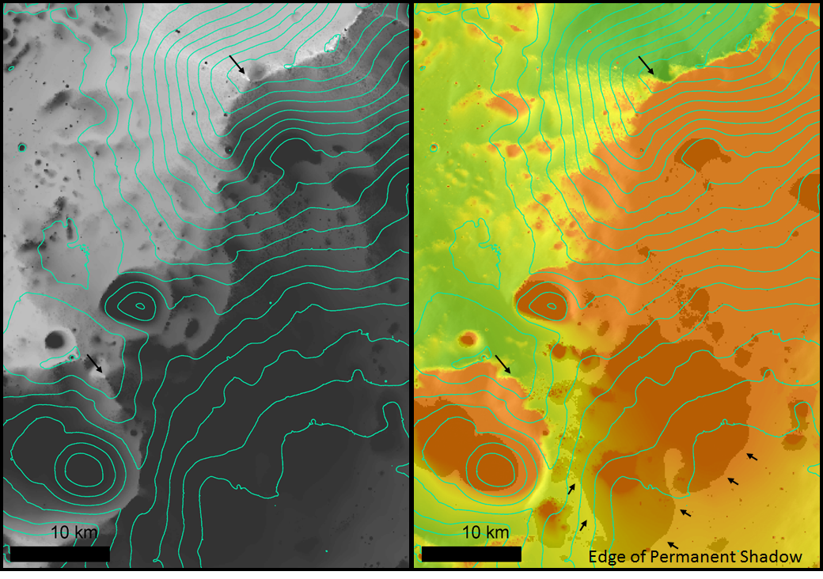
Site Selection: Rim Station
Left: Sunlight, Right: Earth Line-of-sight, 500 m contour

Slide 19
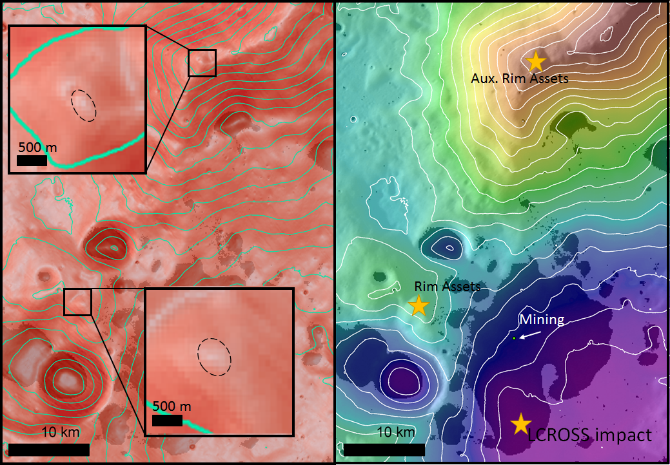
Site Selection: Entire Asset Deployment
Left: Slopes, Right: Elevation (-4 -> +4 km), 500 m contour

Slide 20
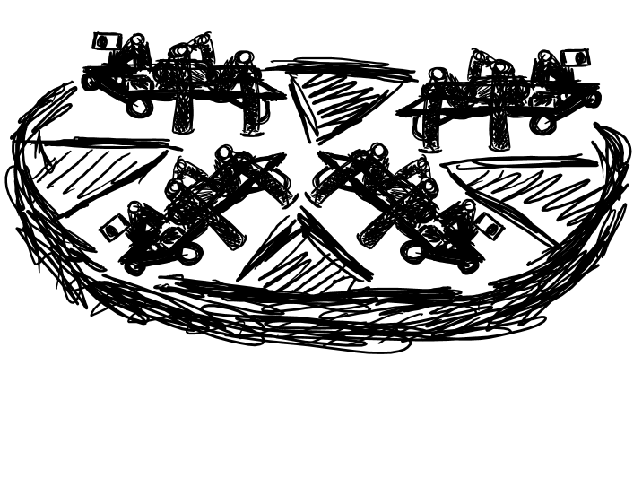
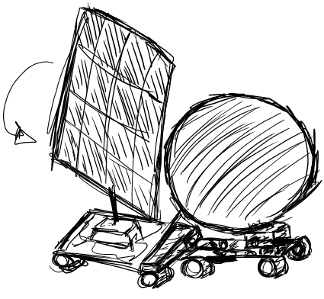
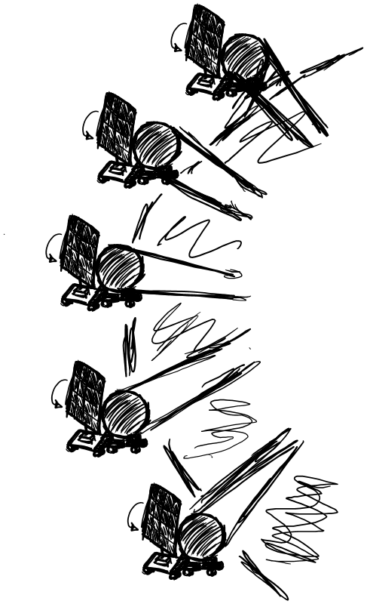
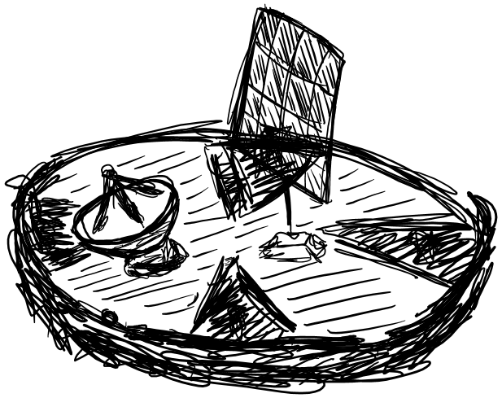
Phase I: Power Station Deployment (2024)
Lunar Landing System (LLS)
Nickname: The Pizza Delivery Truck
Rovers delivered: max 6
Diameter: 4 m
Deliverable mass: 4 mT
Launch mass: 9 mT
Additional uses:
Carries constructor modules instead of unplaced rovers
Can deliver and house ISRU unit
Each concentrator is deployed into location by a wheeled rover hauling a tractor with deployable solar array.
Five solar concentrators are located at each rim station
The used delivery vehicle deploys telecom system.
Notes:
Lunar Landing System (LLS)
Nickname: The Pizza Delivery Truck
Rovers delivered: 2-6
Diameter: 4 m
Deliverable mass: 4 mT
Launch mass: 9 mT
Additional Use:
Carries constructor modules instead of unplaced rovers
Can deliver and house ISRU unit

Slide 21
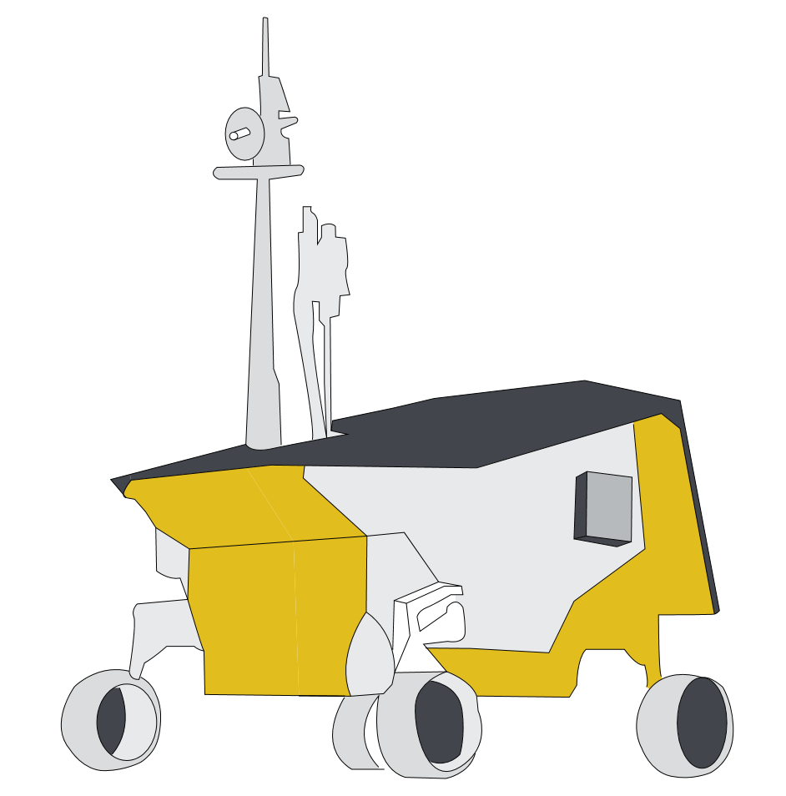
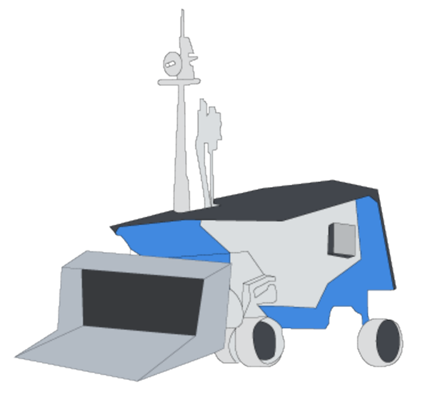
Phase II - Ice Location (2026)
Prospector:
Existing vehicle used for simplicity
- Based on Lunar Polar Volatiles Extractor (LPVE) mission.
Identifies volatile deposits around landing site
- Likely heterogeneous ice distribution
Constructor:
Tractor carries trailer modules
- Bulldozer Unit
- Clears loose regolith
- Robotic Arm
- Attaches cryo hoses and power cabling.
Notes:
TODO: switch

Slide 22
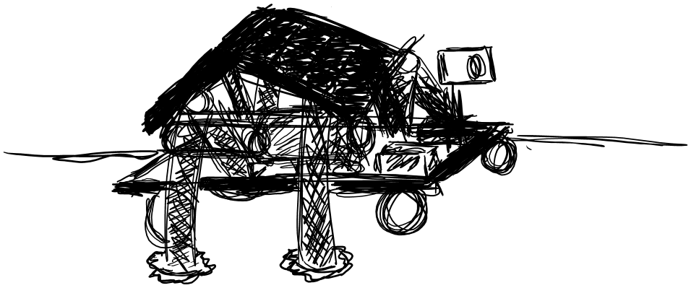
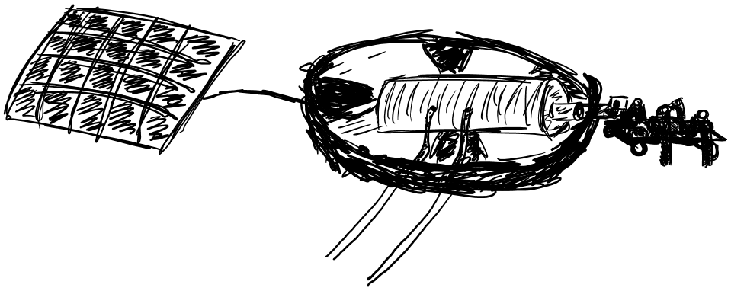
Phase III - Extraction (2027 & 2028)
Solar Arrays
Extractors
(+) Total Number: 12 (6+6)
(+) PVEx Drills: 4 per rover
(+) H₂O Rate: 12 kg/day/rover
(+) Power: 1 kW solar
Water Tank (Liquid Storage)
Drills
ISRU System:
Extractor H2O Drop-Off
ISRU Unit
(+) Splits H₂O at 70 kW beamed from Cabeus rim.
(+) Pressurized vapor-fed PEM Electrolyzer.
(+) LOX/LH₂ stored in LRS vehicles (landed Centaurs).
Electrolyzer Unit
Solar Farm
Cryogenic Fuel Lines (Heated)

Slide 23
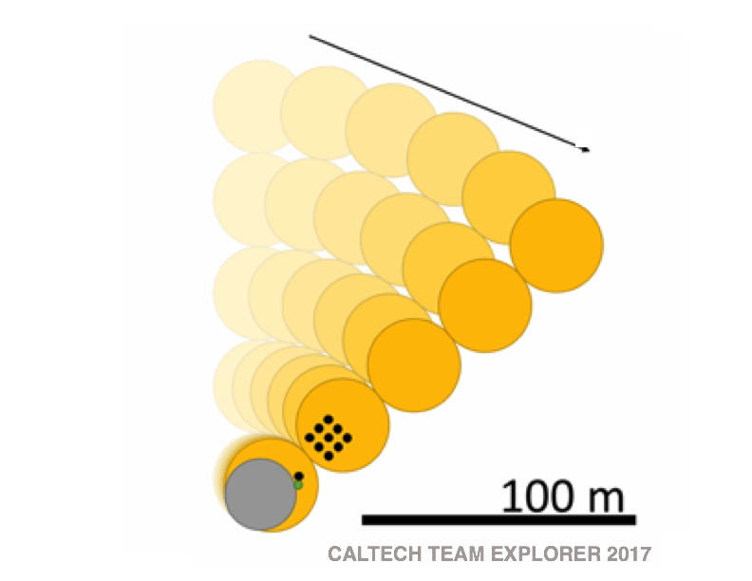
Operations
spotlights
solar array
electrolysis unit
rovers
Phased autonomous operations
Proximity fail-safe mode
Low energy operations during blackout
Access to 600x fuel needed
Future human friendly
34 m
Regolith → Water → LOH + LH2
Extractors (Rovers with Honeybee core drills) PEM Electrolyzer
Powered using solar using concentrated mirrors

Slide 24
Operations: Transfer
As rovers collect ice, it is brought back to the ISRU
Electrolysis
Transferred to Landing Resupply Shuttle (LRS)
Electrolysis Unit
(ISRU)
Hose
LRS
Construction
Rover

Slide 25
Architecture Pros
SOLAR: Scalable, movable, does not sublimate ice
Many redundant systems
Existing or near-existing technology (High TRL)
Modular
Easy maintenance
Lasers have double loss from photon -> electric conversion
Nuclear is also expensive (entire $15G to fuel mining ops)
Microwave couples to regolith and sublimates ice

Slide 26
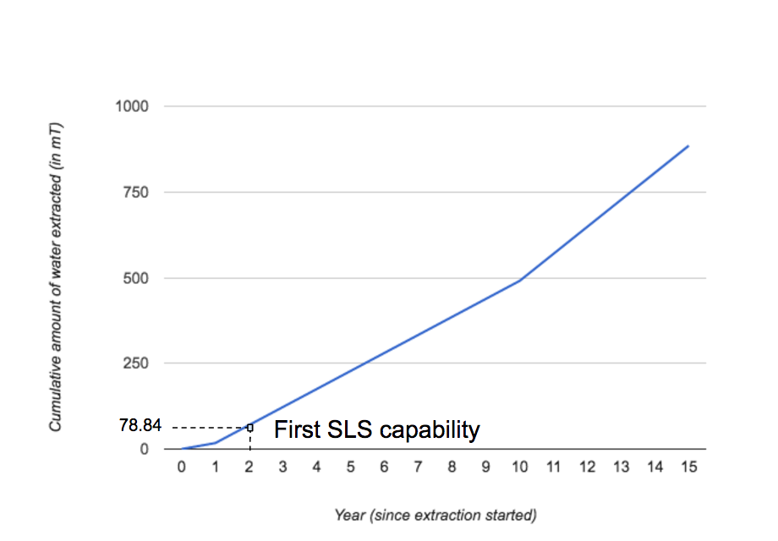
Production | Operation Estimates
50 mT of H₂O processed every year with 12 rovers
Lifetime: Estimated 15 years due to radiation on PVs
Rate: 2x needed to refuel SLS
Year 0: 2027

Slide 27
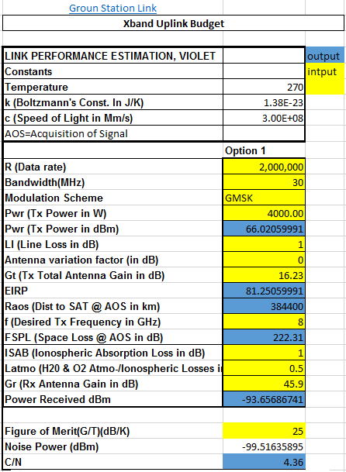
Communications
Rovers/ground support locally communicates with repeater station on rim, with 95% line of sight to Earth
Rim repeater deployed with the rover platform
Rotating photovoltaic panel for power supply
Phased Autonomy:
- systems start off with high levels of telepresence
- phases to more autonomy as tasks become more general
Specs:
- X-band communication
- 4kW TX
- Spaceflight Industries ground station for constant cheap communication

Slide 28
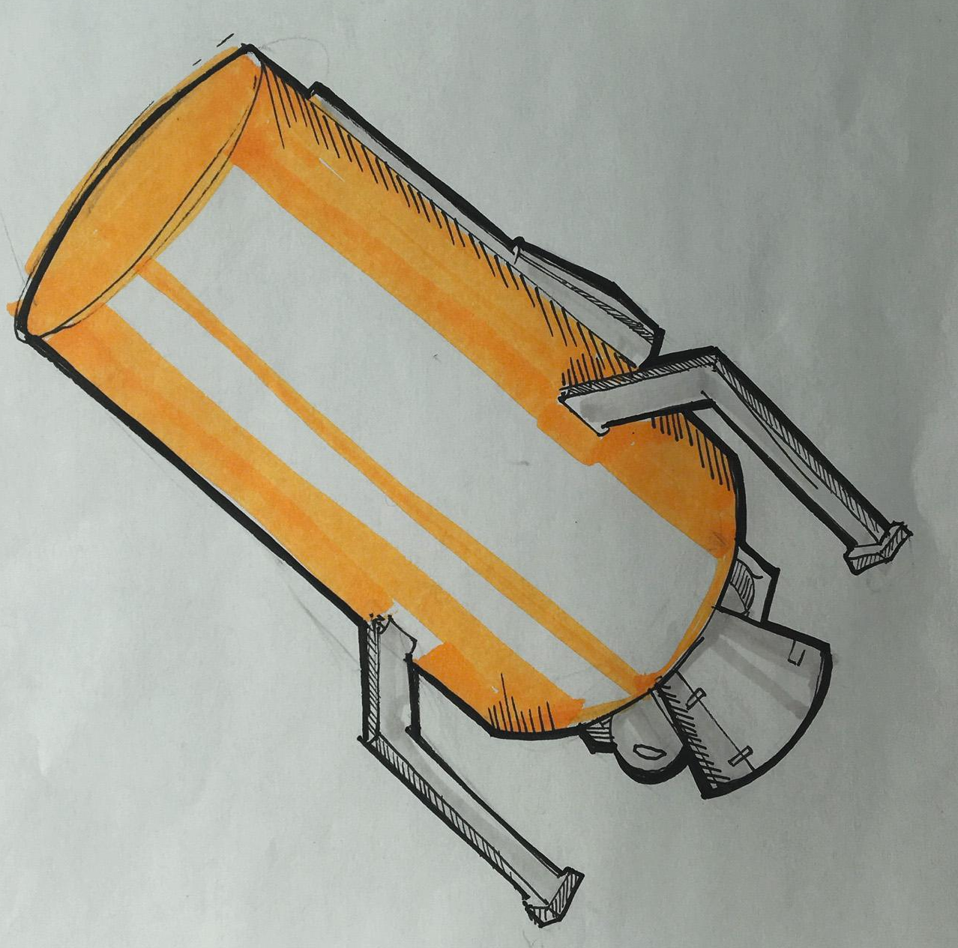
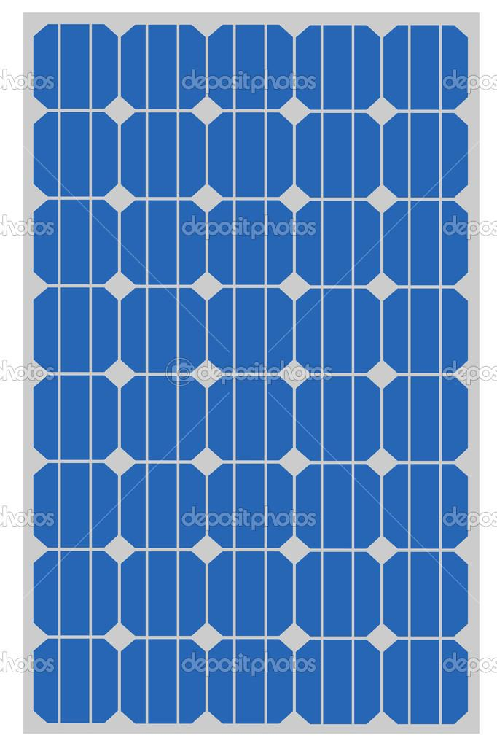
Lunar Resupply Shuttle (LRS)
Requirements:
Must use LH2/LOX as propellant
Must be massive enough to transport reasonable amount of fuel
Must have self-sustaining power systems
Must be modified to be reusable/landable
- More sensors, update avionics system
- Landing legs
- Attitude control thrusters
- Internal pressurant supply
Considerations:
- EUS
- Centaur
- ACES
Centaur Single Engine

Slide 29
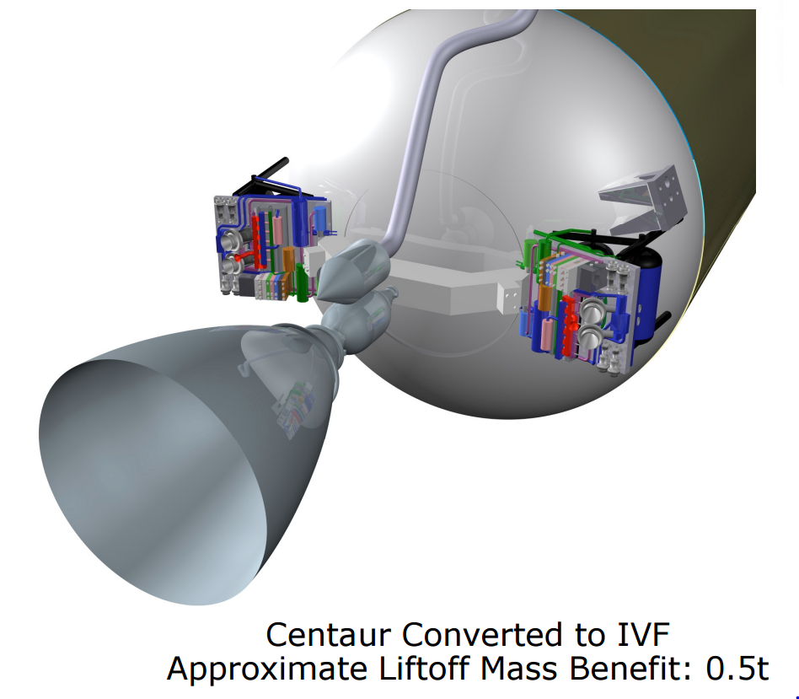
Cryogenic Propellant Storage
Existing technology
ULA’s Integrated Vehicle Fuel system + 60-layer multi-layer Insulation (MLI)
Reduces boil-off by 50-70%
Uses boil-off for:
- Pressurant
- Attitude control
- Ullage acceleration
Simplifies plumbing
Reduces all fluids to LH2 and LOX
Provides some spacecraft power
Centaur tanks with MLI loose ~0.1% per day
Total boil-off: >3% per month

Slide 30
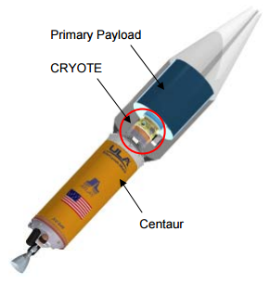
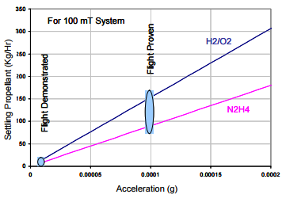
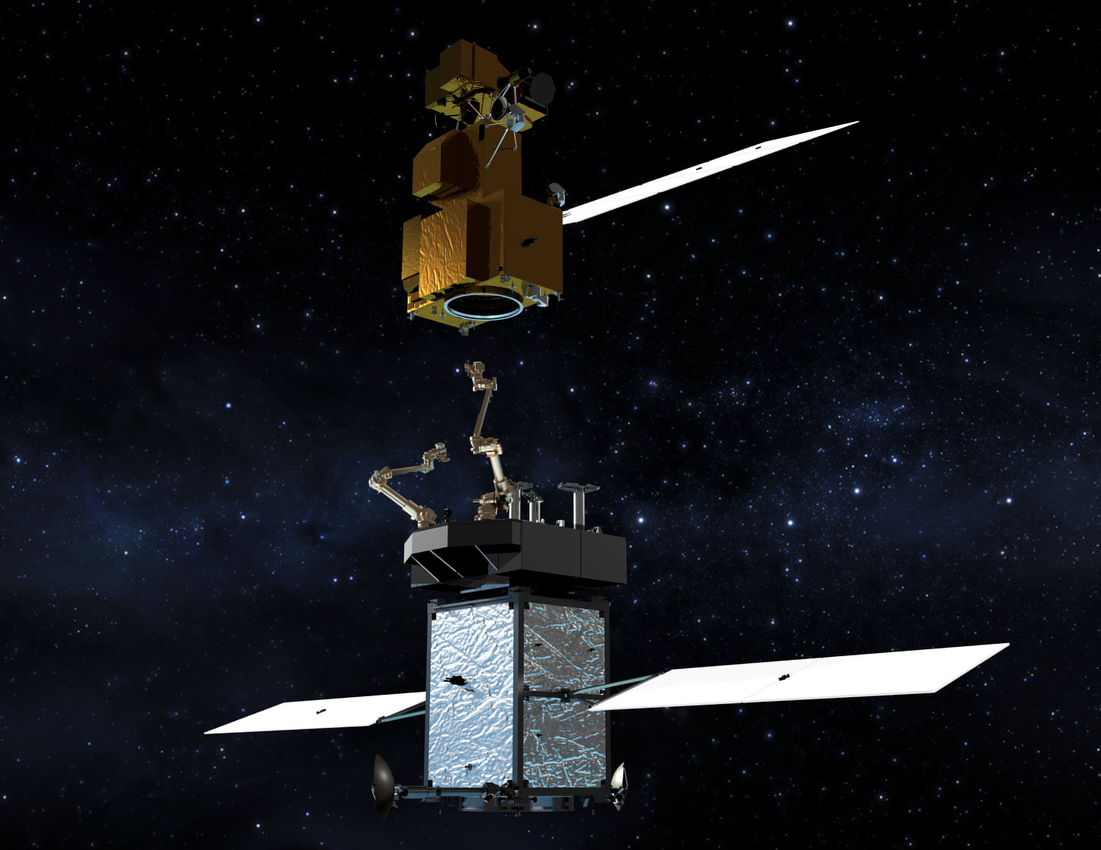
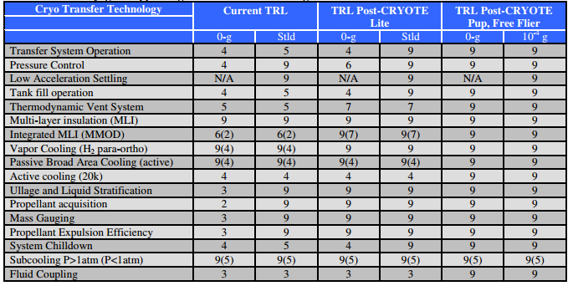
Cryogenic Propellant Transfer in Space
NASA Restore-L Robotic Refueling mission
Flight proven fuel transfer rates
Cryogenic Orbital Test
Transfer rates of 150 kg/hour flight proven
Low centrifugal acceleration (0.001 g from 5 rpm rotation)
Approximately 2 days to transfer 6 mT of propellant from Centaur
TRL of cryogenic transfer technology fully mature this decade

Slide 31
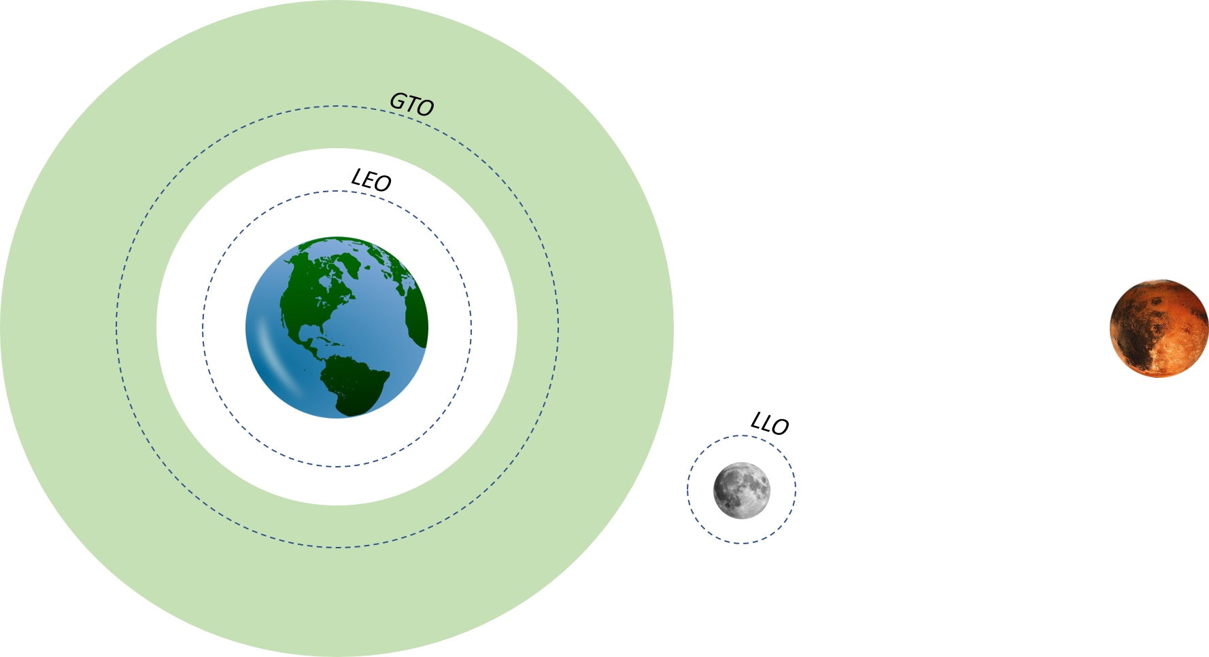
Fuel Resupply Orbit Tradeoffs
LEO:
Large EUS payloads can be injected to Mars
Too costly for the LRS (~11 km/s round-trip)
LLO:
EUS Payload mass to Mars limited to ~38 mT
Additional ∆V required to lower perigee
Docking difficulties: No GPS at LLO. Autonomy issues.
L1, L2:
Restricted three-body problem (further analysis require)
Docking challenges

Slide 32
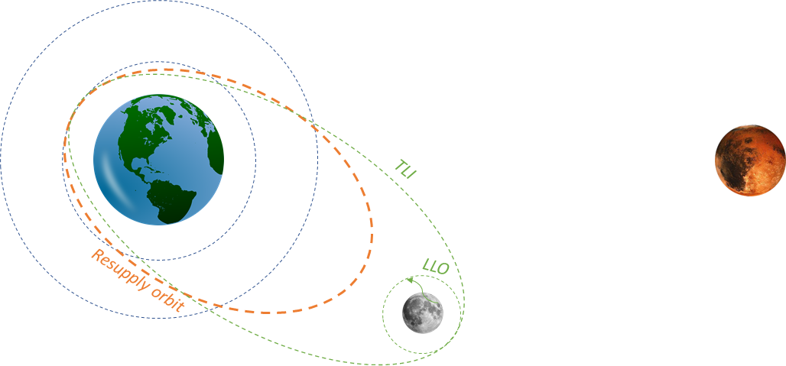
LRS Baseline Trajectory
Injection into polar LLO (~1.6 km/s)
Trans Earth Injection (~0.8 km/s)
Elliptical Resupply Orbit Injection (Apogee altitude is our optimization variable) and rendezvous (Time of flight: 60 to 100 hours)
Docking (~20 m/s): Autonomous/non-autonomous docking using GPS, IMU, AVGS (Advanced Video Guidance System)
Trans Lunar Injection
Landing (~1.6 km/s)

Slide 33
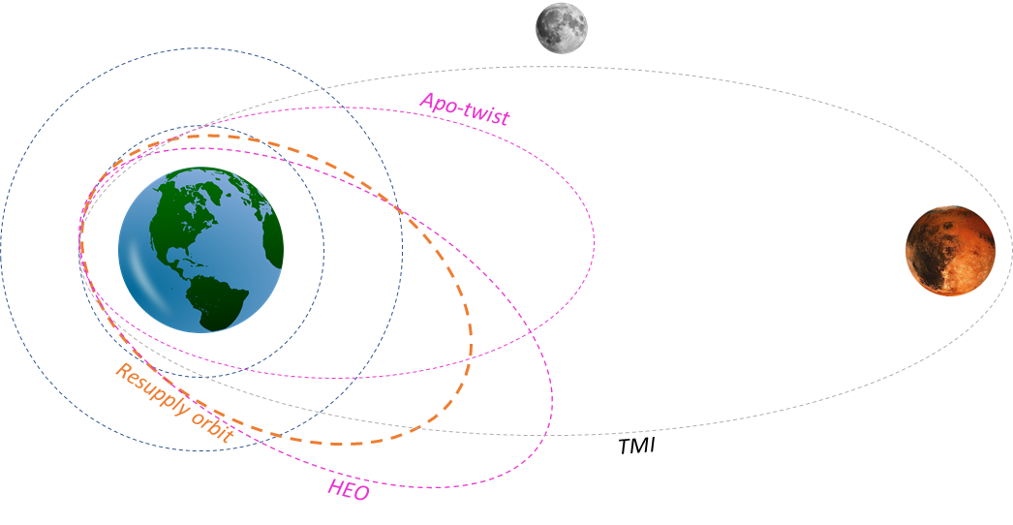
EUS Baseline Trajectory
SLS injects EUS into the Resupply Elliptical Orbit (Apogee altitude is our optimization variable)
Rendezvous and docking
HEO injection: apo-twist cost reduction
Apo-Twist required for the 2033 launch (~45º change in argument of periapse, ~1.5 km/s)
Docking (~20 m/s): Autonomous/non-autonomous docking using GPS, IMU, AVGS (Advanced Video Guidance System)
Trans Mars Injection

Slide 34
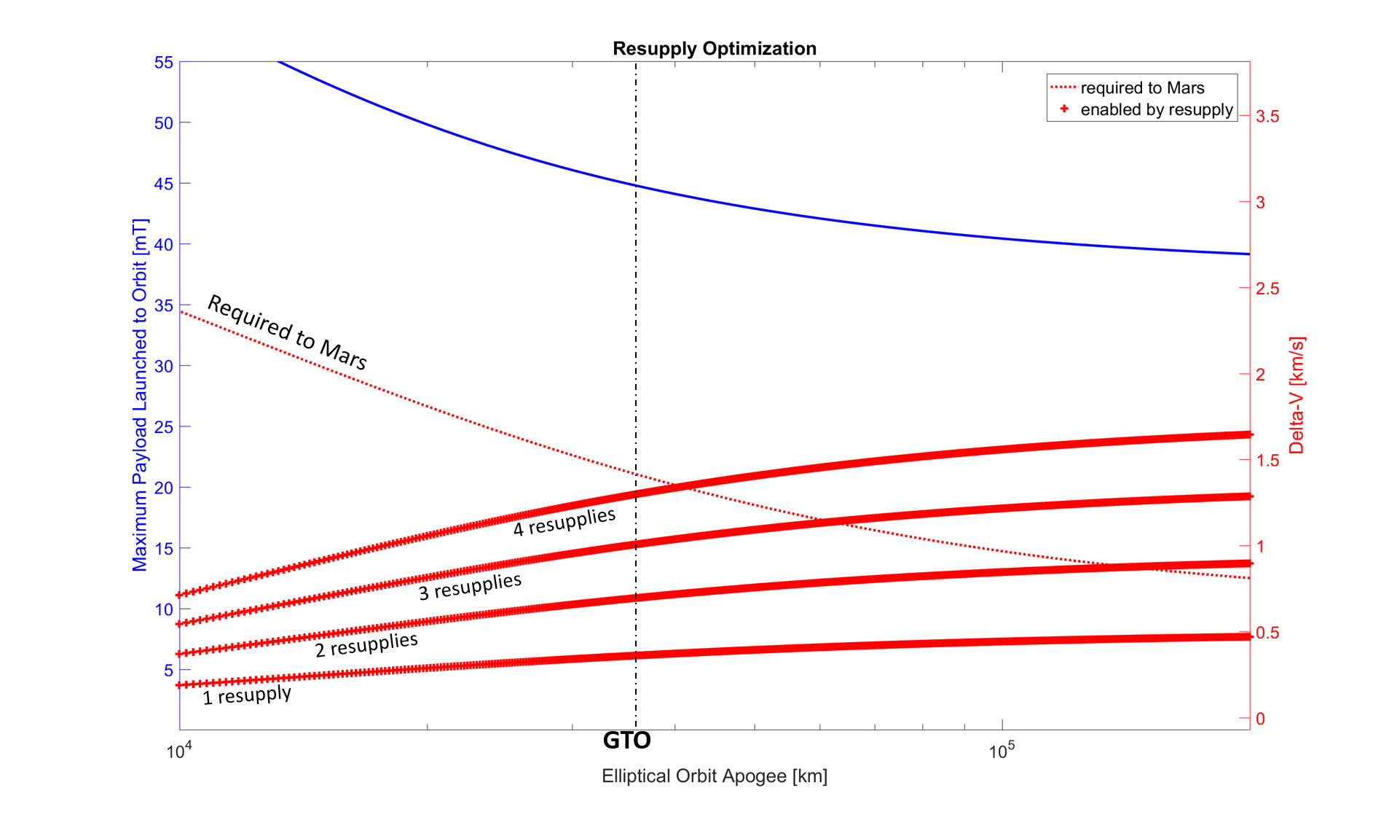
Propellant Resupply Optimization
CALTECH TEAM EXPLORER 2017

Slide 35
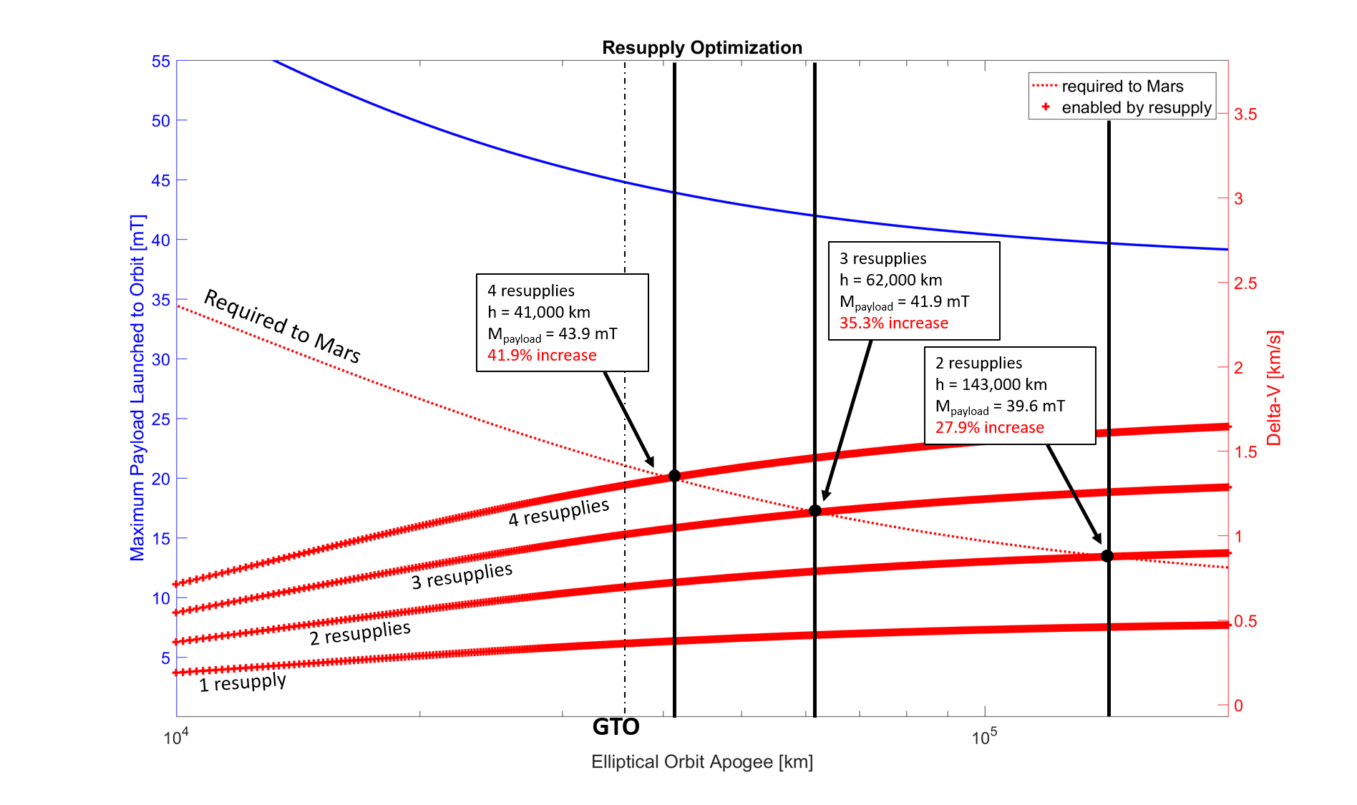
Propellant Resupply Optimization
CALTECH TEAM EXPLORER 2017
Notes:
2.3 mT
4.3 mT

Slide 36
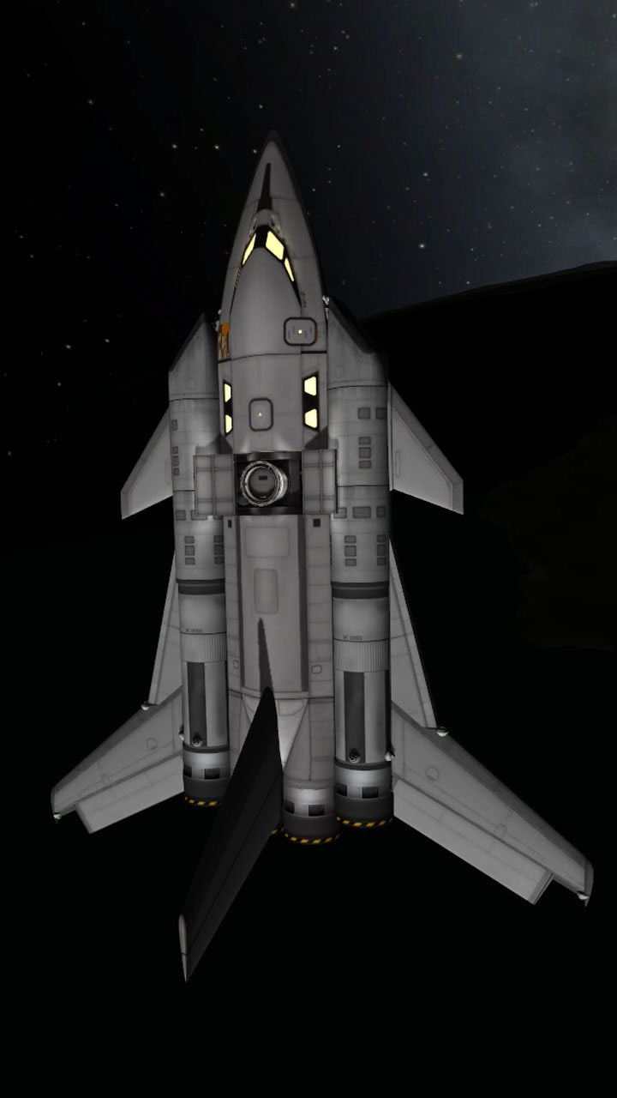
Missions to the Outer Solar System
Not yet fully characterized or optimized
Initial calculations suggest excellent performance
+250% direct to Saturn
+700% direct to Pluto
- Assuming launch on an Atlas V 551 and refuel in GTO
Bigger missions, bigger science, better value

Slide 37
Estimated Cost To Full Operation
Annual Cost
Initial investment: $10.2B
Peak Rate: $1.6B/year
Operations: $0.08B/year
Cumulative Cost

Slide 38
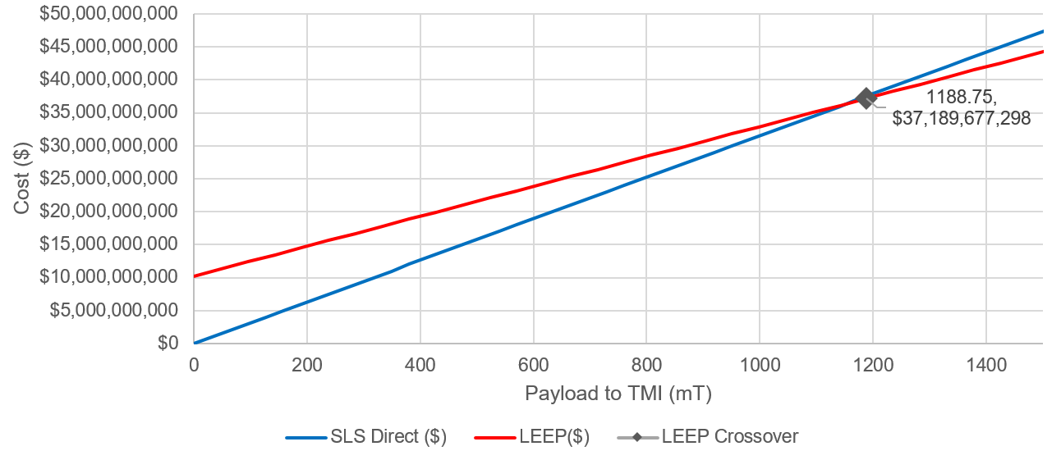
TMI Payload Cost

Slide 39
Project Risk
Knowledge Management
Stakeholder and Funding Stability
Scope Creep
Regulatory and Political Risk
U.S. Domestic
Economic incentives
Environmental impacts
Space policy alignment
Funding stability
International
Export Control Compliance
Compliance with International Law: Outer Space Treaty and Moon Treaty

Slide 40
Public Outreach Strategy
Audience: broad appeal, broad audience
Impacts:
- 1) Drive momentum towards SLS’s upcoming launches
- 2) Normalize the idea of extended human establishments off earth
- Inspire students indirectly and directly with internships
Schedule:
- Students through internships through design phases and operations
- Launch, landing, and “firsts.”
Media Mix:
- Traditional media
- New media channels
- Tangible experience for members of the public to interface directly with the mission.

Slide 41
Public Outreach Ideas
Virtual reality & games
Student project partnership with a university team: continuing from the example of missions like the REXIS sub-mission on OSIRIS-REx mission and IRIS on the proposed Moonrise mission
Time capsules: this mission will create a lot of holes! Members of the public could even drive a rover to place their time capsule in the hole.
Notes:
Virtual reality & games: drive one of the mining rovers on the moon! Look out over a lunar crater. Stargaze from a permanently shadowed region.
Student project partnership with a university team: continuing from the example of missions like the REXIS sub-mission on OSIRIS-REx mission and IRIS on the proposed Moonrise mission, there is tremendous potential to inspire and train the next generation of scientists, engineers, and designers.
Time capsules: this mission will create a lot of holes! Members of the public could even drive a rover to place their time capsule in the hole.
Lunar streaming webcam: streaming webcams have become a popular element of social media feeds. While the communications budget makes a high-resolution live stream infeasible, a short-duration livestream or a semi-frequently updated “earthrise” image could fundamentally change the public’s relationship with their own planet by allowing anyone to view earth at a distance at any nearly time.

Slide 42
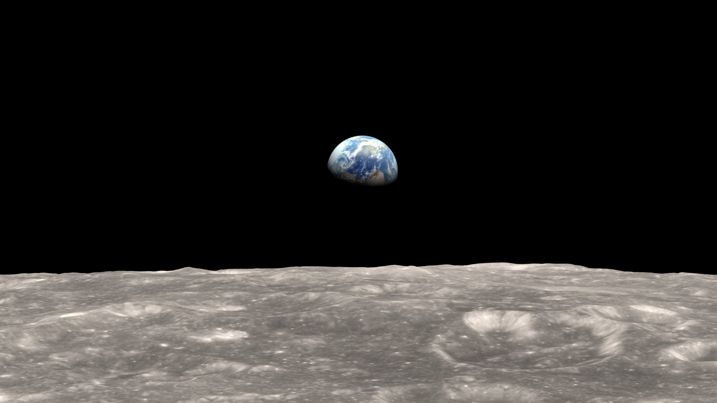
Public Outreach Ideas
Lunar streaming webcam: short-duration live stream or a
semi-frequently updated “earthrise” image could fundamentally change the public’s relationship with their own planet by allowing anyone to view earth at a distance at any nearly time.
Notes:
Virtual reality & games: drive one of the mining rovers on the moon! Look out over a lunar crater. Stargaze from a permanently shadowed region.
Student project partnership with a university team: continuing from the example of missions like the REXIS sub-mission on OSIRIS-REx mission and IRIS on the proposed Moonrise mission, there is tremendous potential to inspire and train the next generation of scientists, engineers, and designers.
Time capsules: this mission will create a lot of holes! Members of the public could even drive a rover to place their time capsule in the hole.
Lunar streaming webcam: streaming webcams have become a popular element of social media feeds. While the communications budget makes a high-resolution live stream infeasible, a short-duration livestream or a semi-frequently updated “earthrise” image could fundamentally change the public’s relationship with their own planet by allowing anyone to view earth at a distance at any nearly time.

Slide 43
A leap for mankind: LEEP as a platform for the future

Slide 44
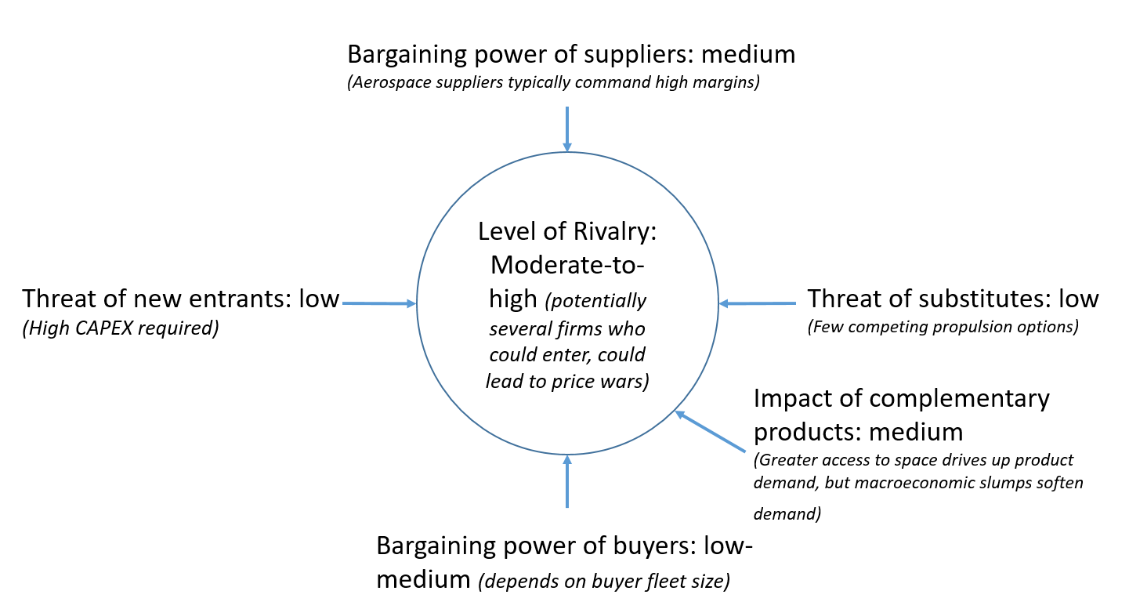
Fuel As A Service: The Next Space Industry
Key Businesses
Fuel transfer for Martian or Jovian system human missions Fuel transfer for DS robotic missions Rescue | Satellite removal tug Waypoint destination for interplanetary tourists Transfer tug for lunar operations
Notes:
Right now there are fundamentally three space businesses: Telecom, earth observation, and global navigation satellite system (GNSS)
Refueling using modified Centaur upper stages
Highly modular, robust to failure, allows refueling flexibility
27.6% increase in total mass to TMI
45% increase in usable payload mass to TMI
Performance gets better for more energetic targets:
250% increase in usable payload mass direct to Saturn
700% increase in usable payload mass direct to Pluto

Slide 45
Areas for Public-Private Cooperation
Subsystem design and operation (rover, extraction technology, power systems)
Autonomous operations
long-duration mission planning
extreme condition engineering (Permanently shadowed regions)

Slide 46
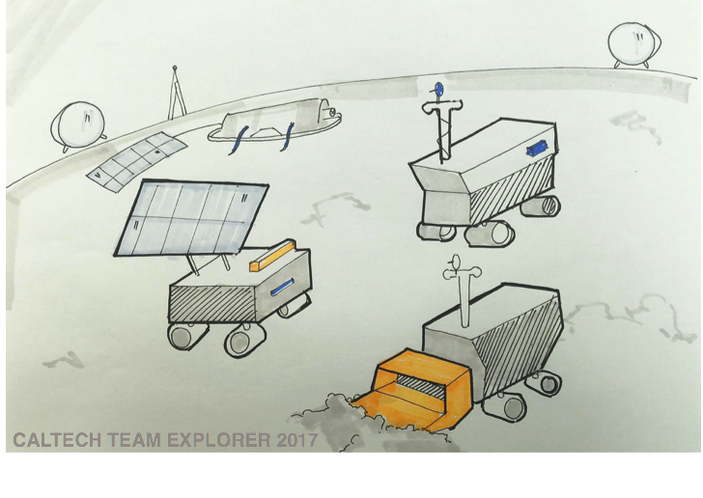

Slide 47
Caltech Space Challenge 2017 Sponsors

Slide 48
Backup

Slide 49
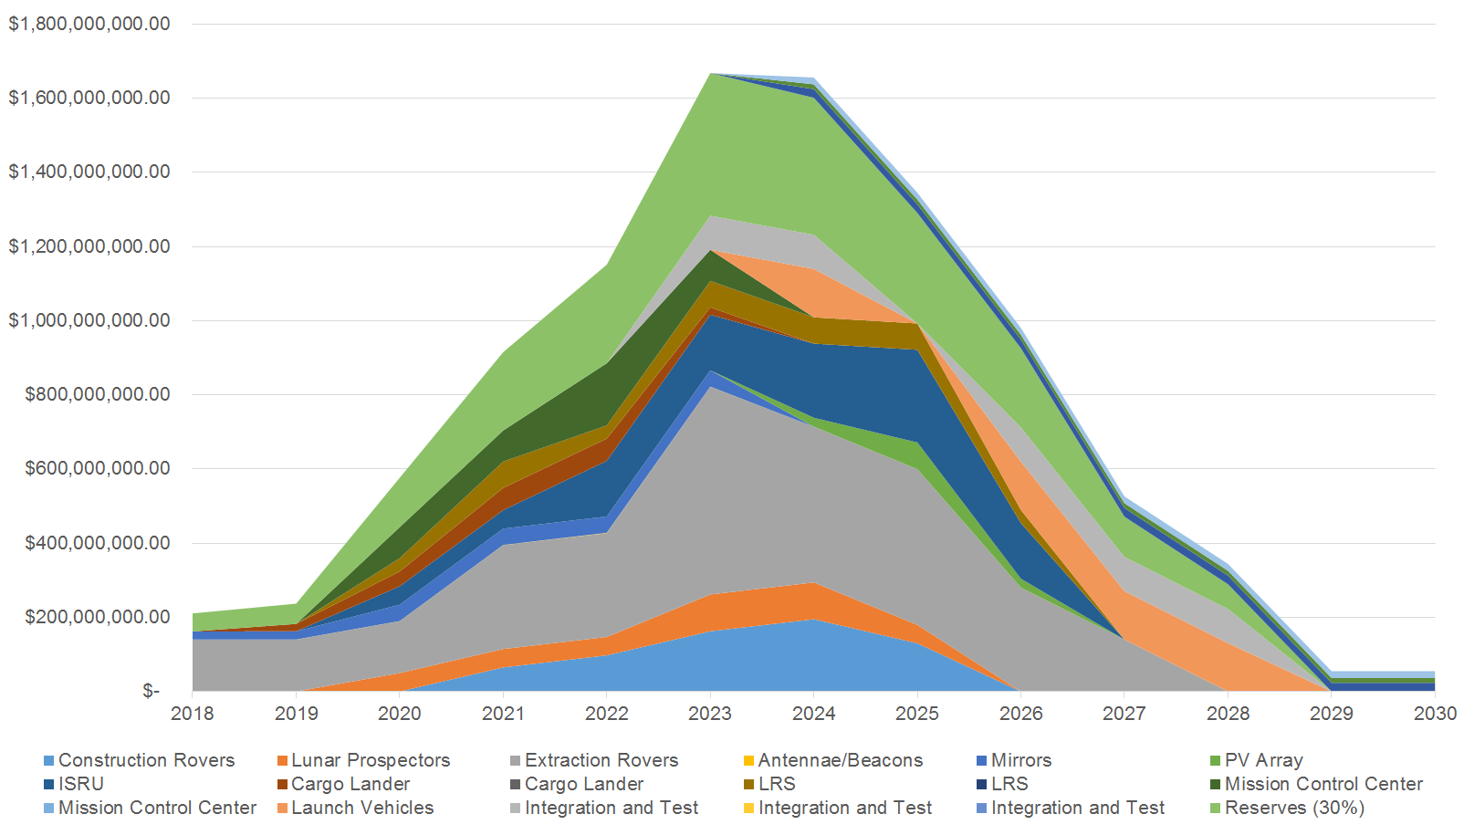
Cost

Slide 50
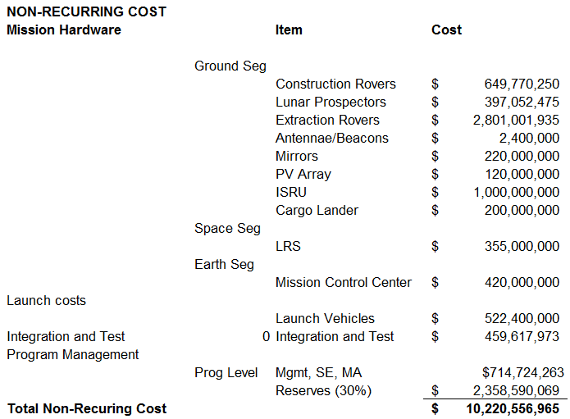
Cost

Slide 51
Cost

Slide 52
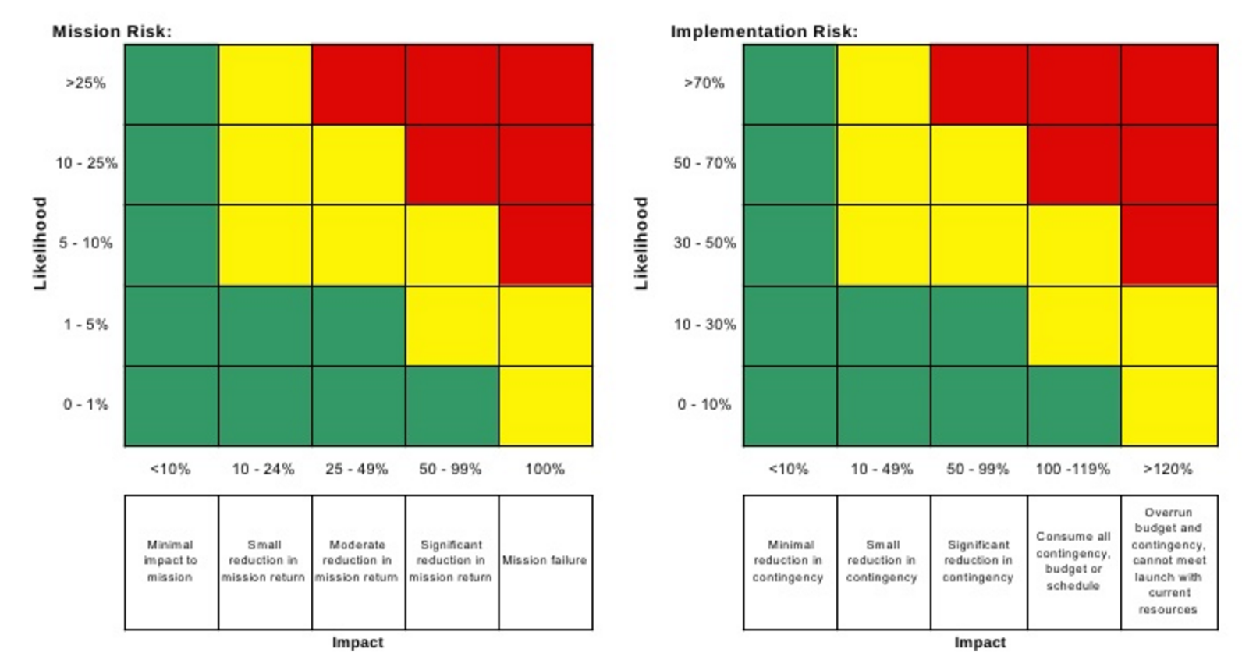
Risk Management
Risk analysis based on the NASA Risk Management Handbook
3 levels of risk: System, Ground segment and Space segment.
System Level:
Budget
Service Availability - Single Point of Failure
Ground Segment Level:
Lack of water
LRS crash into main base
Mirror technology
Excavation, prospection or construction rover loss
Space Segment Level:
Crash during rendezvous
Landing
Leaking
Zero boil-off
=> Translation of impact and likelihood ratings into Red-Yellow-Green for NASA 5x5 risk matrix

Slide 53
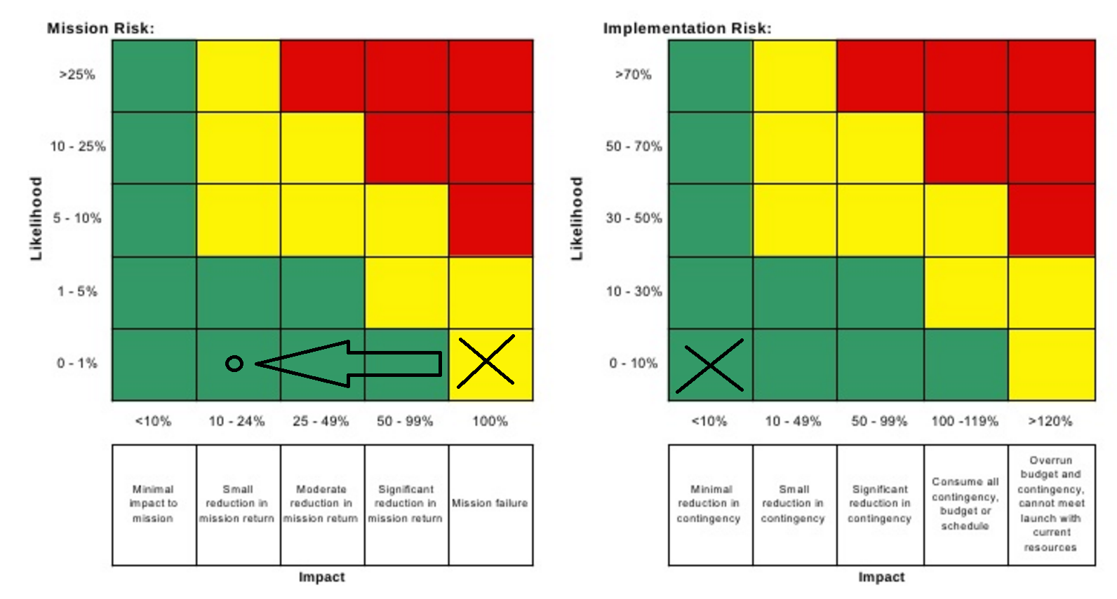
Technical Risk
Risk: Crash during rendezvous and proximity operations.
Mitigations: Software safe-modes, use of high-experience systems, and teleoperations.
Others: Low water content, mirror technology, excavation rover rate.

Slide 54
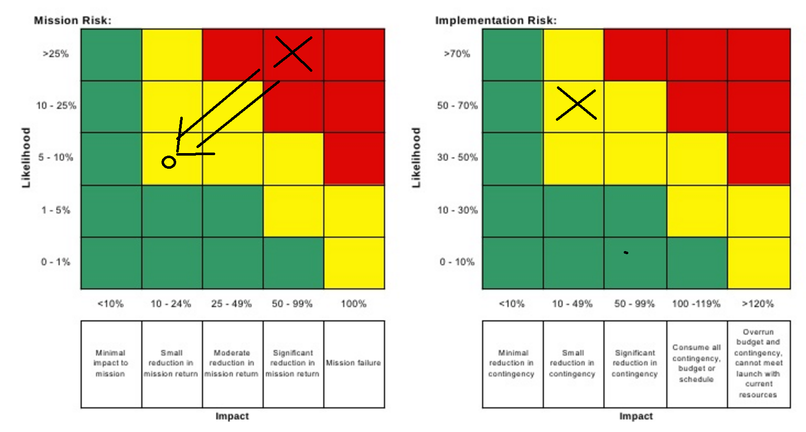
System Level Risk (1/9)
Risk: Budget
Mitigations: Use margins, use off-the-shelf products

Slide 55
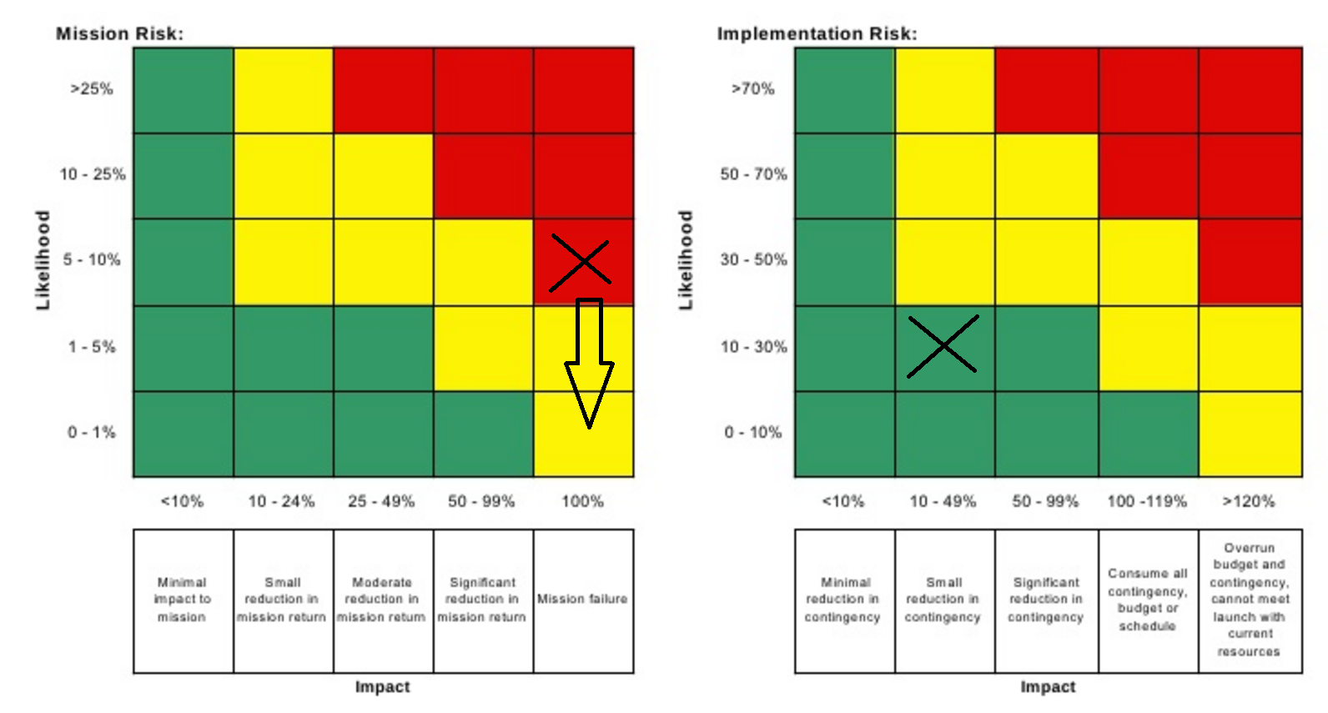
System Level Risk (2/9)
Risk: Service Availability - Single Point of Failure
Mitigations: installing a reservoir station

Slide 56
Technical Risk (3/9)
Risk: Landing
Mitigations: algorithm and sensor improvements, smoother pads, LRS backups

Slide 57
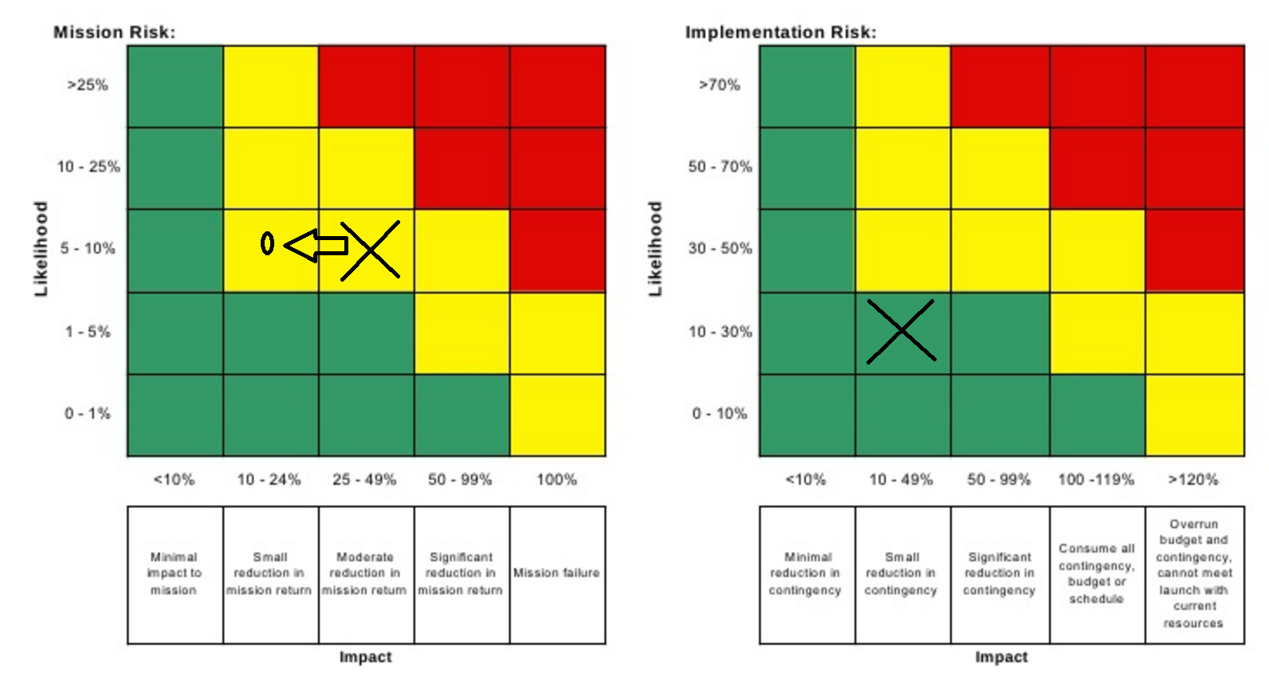
Technical Risk (4/9)
Risk: fluid leaking
Mitigations: leaking detection sensor, security checkpoints

Slide 58
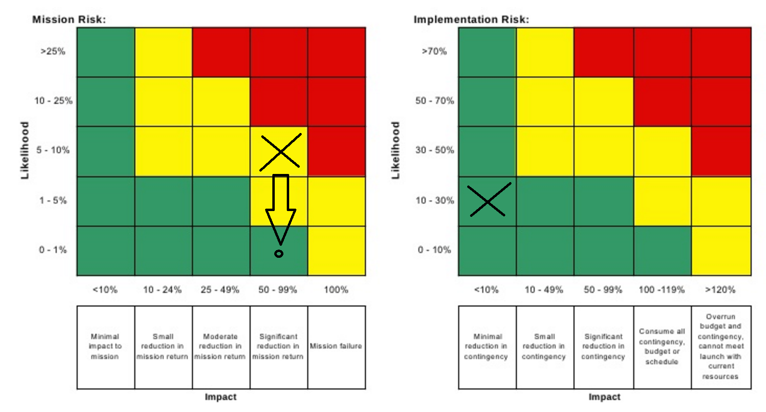
Technical Risk (5/9)
Risk: Zero boil-off
Mitigations: implement 60-layer MLI on the hydrogen tank and implement ULA’s IVF system for integrating vehicle fluids and limiting boil-off.

Slide 59
Other Technical Risk (6/9)
Risk: lack of water
Mitigations: using prospecting rover, deploy to another crater

Slide 60
Other Technical Risk (7/9)
Risk: LRS crash into main base
Mitigations: reasonable distance between launching pad and ISRU, fixing the damages with the rovers, launch maintenance from Earth

Slide 61
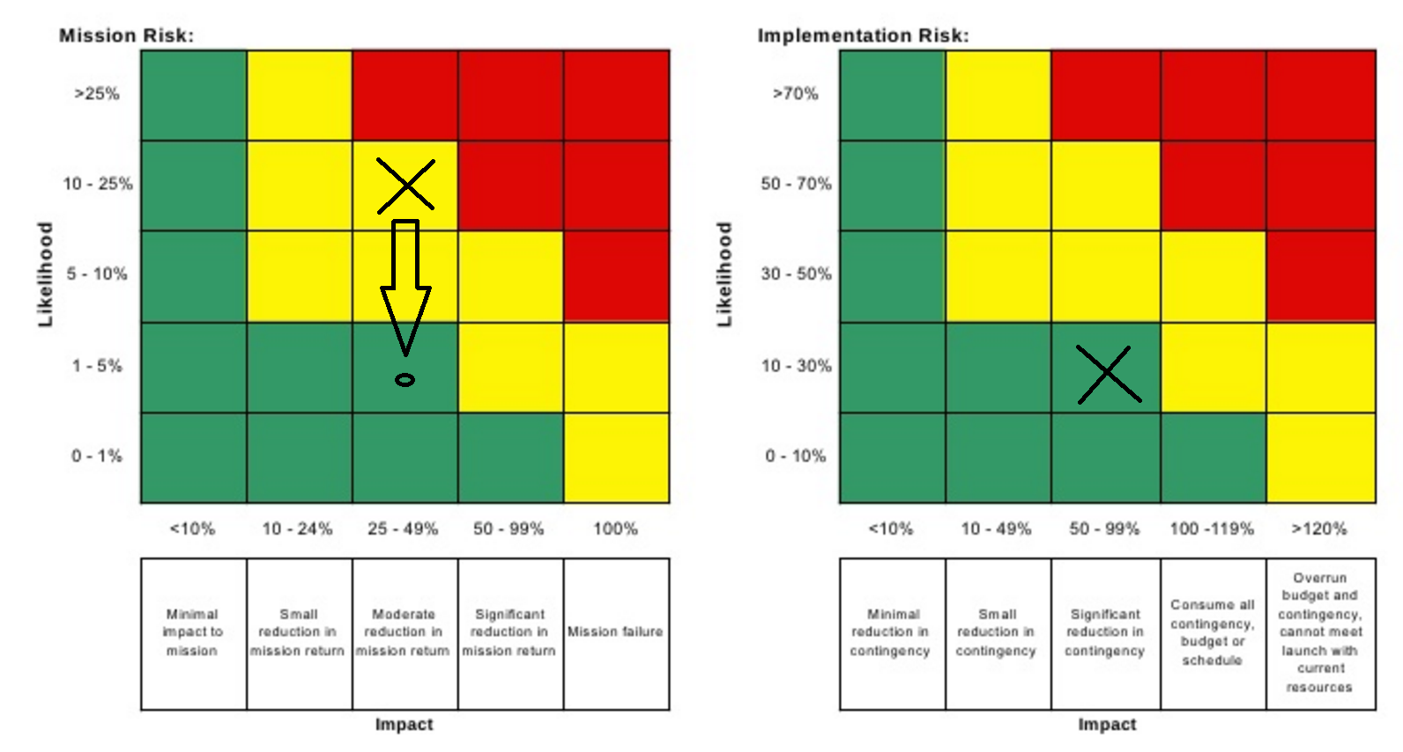
Other Technical Risk (8/9)
Risk: Mirror (Technology Readiness Level)
Mitigations: deploy smaller mirrors on the rim.

Slide 62
Other Technical Risk (9/9)
Risk: Excavation, prospection or construction rover loss
Mitigations: having rover spares, having in-built maintenance capability, launch maintenance material from Earth

