Slide 1

Radiation Risks and Challenges Associated with Human Missions to Phobos/Deimos
Presentation to the
Caltech Space Challenge
Sponsored by the
Keck Institute for Space Studies
March 26, 2013
Dr. Ron Turner, Fellow
Ron.Turner@anser.org
Analytic Services Inc (ANSER)
Suite N-5000
5275 Leesburg Pike
Falls Church, VA 22041

Slide 2
Acknowledgements
Thanks to:
  The organizers for inviting me
  Dr. Francis Cucinotta, NASA JSC, who provided the starting point for many of the slides in this presentation
  Kalki Seksaria, Thomas Jefferson High School for Science and Technology, who looked at the problem of “how bad can a solar particle event be” over the summer of 2011
However:
  The final slides are my own, so any errors are my own and do not represent NASA’s official position

Slide 3
Outline
Key take-aways
Significance of Radiation
Radiation Environment
  Galactic Cosmic Radiation
  Solar Particle Events
Effects on Electronics and Materials
Radiation Health Risks to Astronauts
Shielding Strategies

Slide 4
Key Take-Aways
Radiation is a significant risk to deep space exploration
  Long term cancer risk
  Shorter term, mission limiting health effects
Galactic Cosmic Rays are extremely difficult to shield
  Exposure to GCR will be the mission limiting factor
Solar Partice Events can be shielded but there must be :
  Sufficient warning
  Adequate shelter, and
  An operations concept that allows time to reach it

Slide 5
Significance of Radiation
Every review of NASA’s exploration activities has identified space radiation effects on crewmembers as a top health and safety issue that NASA must address
Health risks are limiting factors in mission length and crew selection
Large costs to protect against health risks and uncertainties
  Dr. Francis Cucinotta
  Chief Scientist
  NASA Space Radiation Program

Slide 6
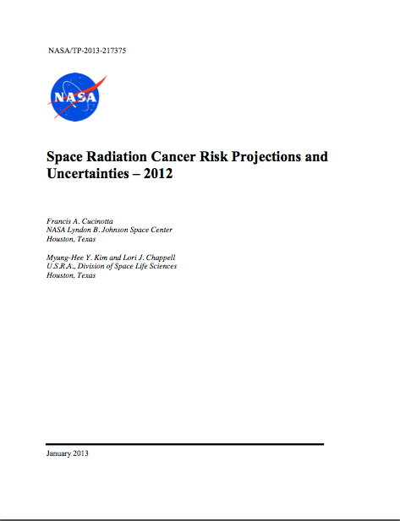
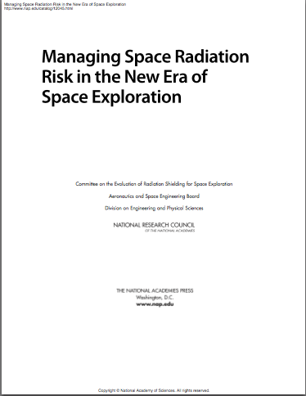
Recommended References

Slide 7
Space Radiation Environment

Slide 8
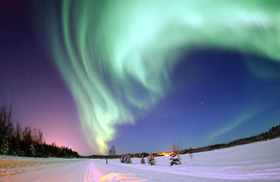
Radiation Environment
Galactic cosmic rays (GCR) are continuous, low flux, very penetrating protons and heavy nuclei
  A biological science challenge -- shielding is not effective
  Large biological uncertainties limits ability to evaluate risks and effectiveness of mitigations
  Shielding has excessive costs and will not eliminate galactic cosmic rays (GCR)
Solar Particle Events (SPE) are intense periods of high flux, largely medium energy protons
  A shielding, operational, and risk assessment challenge--shielding is effective; optimization needed to reduce weight
  Typically one to two per month in solar active years
  A few per 11-year cycle may be large enough to cause acute effects to astronauts who cannot achieve the shelter within a few hours
  Accurate event alert and responses is essential for crew safety
Secondary Radiation produced in shielding consists largely of protons, neutrons, and heavy ions
Trapped Radiation is not considered in this assessment

Slide 9
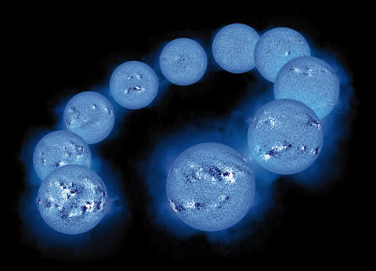
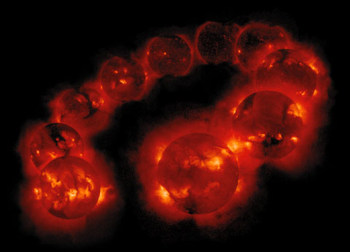
Solar Cycle
Intensity of solar activity varies over an ~11-year (22-year) solar cycle
Variation is caused by changes in the global solar magnetic field

Slide 10
Galactic Cosmic Rays

Slide 11
Galactic Cosmic Radiation
Cosmic rays are high energy charged particles that travel at nearly the speed of light and come equally from all directions
Galactic cosmic rays (GCR) come from sources outside the solar system, distributed throughout our Milky Way galaxy and beyond
The GCR are the nuclei of atoms, ranging from the lightest to the heaviest elements in the periodic table
  About 90 percent are protons
  About 9 percent are helium nuclei
  About 1 percent is “everything else”

Slide 12
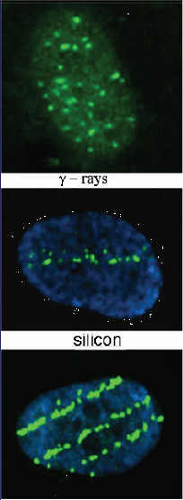
Galactic Cosmic Radiation (cont)
GCR are fairly low intensity (“cosmic drizzle”)
GCR are extremely energetic, thus very penetrating and destructive
GCR intensity varies inversely with the solar cycle:
  GCR is maximum at solar minimum
  Lower energies are most affected by solar cycle
γ rays
silicon
iron

Slide 13
Free Space GCR Environments at 1 AU
(Grouped by Nuclear Charge)
1977 Solar Minimum (solid)
1990 Solar Maximum (dashed)
Z = 1
Z = 3 to 10
Z = 21 to 28

Slide 14
Solar Particle Events

Slide 15
Solar Particle Events
Solar Particle Events (SPEs) are periodic, sudden increases in medium-energy (tens to a few hundred MeV) charged particles
The most significant Solar Energetic Particles (SEPs) are accelerated at the shock of a large fast Coronal Mass Ejection, and rapidly move out along the solar interplanetary magnetic field
  However, in interplanetary space the flux is largely isotropic for most of the event
The probability of an event varies with the solar cycle
  SPE probability peaks in the years around solar maximum
  SPEs can occur at solar minimum
While other particles are also accelerated, protons are the dominant component
  Up to ~10 percent helium
  One percent all other elements

Slide 16
Solar Particle Events
SPEs are high intensity events, with flux orders of magnitude above the GCR background (“cosmic thunderstorm”)
SPEs can not be predicted with sufficient warning at this time
Largest impact would be on EVA opportunities
Under some scenarios, the crew would be away from Earth-centric monitoring networks while near Mars
Accurate event alert and response is essential for crew safety

Slide 17
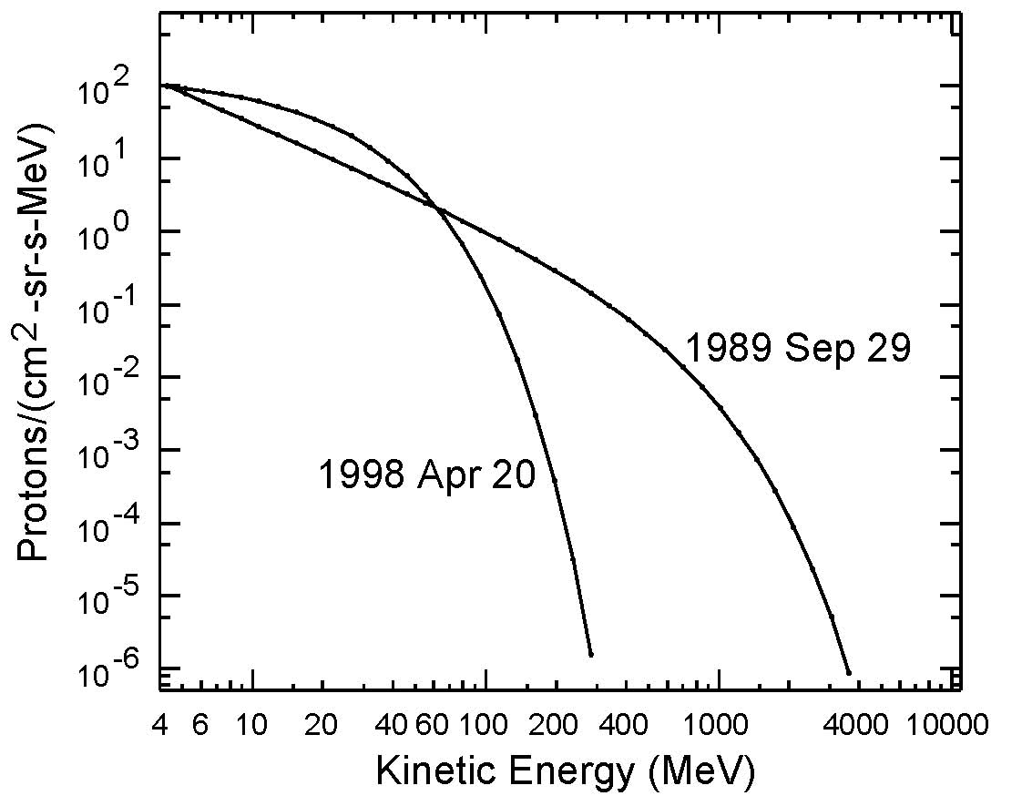
Solar Particle Events (cont)
Solar Particle Events are characterized by:
  Peak Flux
  Total Fluence
  Spectral Hardness
  Time to peak
  Time to decay
Hard vs Soft Spectrum

Slide 18
Forecasting GCR and SPE

Slide 19
Forecasting/Predicting
GCR forecast a few years out is good
  Varies slowly with 11-year solar cycle
  May be inadequate if an unusual cycle is ahead
Solar storms cannot be forecast today
  One to three day forecasts are largely climatological or persistence
  Cannot forecast 1-3 hours ahead
Initial “nowcasting” of storms is not adequate
  When event starts, not clear how bad it will be
  Leads to excessive “false positives”

Slide 20
Space Weather Impact on Materials and Electronics

Slide 21
Impact on Materials and Electronics
Space Weather
Electric and Magnetic fields
Plasma
Particle
radiation
Neutral
gas particles
Ultraviolet & X-ray
Micro-
meteoroids & orbital debris
Charging,
Induced Currents
Ionizing &
Non-Ionizing
Dose
Single
Event
Effects
Drag
Surface
Erosion
Impacts
Biasing of instrument readings
Pulsing
Power drains
Physical damage
Degradation of micro-electronics
Degradation of optical components
Degradation of solar cells
Data corruption
Noise on Images
System shutdowns
Circuit damage
Torques
Orbital decay
Degradation of thermal, electrical, optical properties
Degradation of structural integrity
Structural damage
Decompression
After similar chart by Janet Barth, NASA GSFC
Space Radiation Effects
Source: Space Radiation Effects on Electronics: A Primer for Designers and Managers, by Ken LaBel, NASA GSFC

Slide 22
Radiation Health Risks to Astronauts

Slide 23
Space Radiation Safety Requirements
Congress has chartered the National Council on Radiation Protection (NCRP) to guide Federal agencies on radiation limits and procedures
  NCRP guides NASA on astronaut dose limits
  Forms basis for Permissible Exposure Limits (PELs)
Crew safety
  Limit of 3% fatal cancer risk at 95% Confidence Level
  Prevent radiation sickness during mission
  New exploration requirements limit Central Nervous System (CNS) and heart disease risks from space radiation
Mission and Vehicle Requirements
  Shielding, dosimetry, and countermeasures
NASA programs must follow the ALARA* principle to ensure astronauts do not approach dose limits
  *As Low As Reasonably Achievable

Slide 24
Radiation Health Risks to Astronauts
Four categories of risk of concern to NASA:
  Carcinogenesis (morbidity and mortality risk)
  Chronic & Degenerative Tissue Risks
      Cataracts, heart-disease, immune system, etc.
  Acute Radiation Risks–sickness or death
  Acute and Late Central Nervous System (CNS) risks
    Immediate or late functional changes
Differences in biological damage of heavy nuclei in space compared to x-rays limits Earth-based radiation data on health effects for space applications
  New knowledge on risks must be obtained
Risks estimates are subject to change with new knowledge, and changes in regulatory recommendations

Slide 25
NASA Permissible Exposure Limits
NASA PEL for cancer effects limits effective dose equivalent so that the lifetime “Risk of Exposure Induced Death” does not exceed three percent at the 95 percent confidence interval for a one year mission.
Age (years) | 30 | 40 | 50 | 60
Male, Never-Smoker | 78 cSv | 88 cSv | 100 cSv | 117 cSv
Female, Never-Smoker | 60 cSv | 70 cSv | 82 cSv | 98 cSv
*
NASA PEL for other effects:
 | BFO | Skin | Eye | CNS | Heart
Monthly | 25 cGy-Eq | 150 cGy-Eq | 100 cGy-Eq | 50 cGy-Eq | 25 cGy-Eq
Yearly | 50 cGy-Eq | 300 cGy-Eq | 200 cGy-Eq | 100 cGy-Eq | 50 cGy-Eq
Career | N/A | 400 cGy-Eq | 400 cGy-Eq | 150 cGy-Eq | 100 cGy-Eq
PELs are designed to limit both acute and long term risks to the astronauts
* Example Career Effective Dose limits for one year missions assuming an ideal case of equal organ dose equivalents for all tissues . Source: "Space Ratiation Cancer Risk Projections and Uncertainties - 2012," Cucinotta, F. A., et al., NASA/TP-2013-217375, January 2013.

Slide 26
Safe Days in Space
(Solar minimum with 20 g/cm² aluminum shielding)
Age at Exposure
MALES
35
45
55
FEMALES
35
45
55
NASA 2005
158
207
302
129
173
259
NASA 2012 US Average
209 (205)
232 (227)
274 (256)
106 (95)
139 (125)
161 (159)
NASA 2012 Never Smokers
271 (256)
308 (291)
351 (335)
187 (180)
227 (212)
277 (246)
Estimates of Safe Days in deep space defined as maximum number of days with 95% CL to be below 3% REID Limit. Calculations are for solar minimum with 20 g/cm² aluminum shielding.
Values in parenthesis for the deep solar minimum of 2009. Source: Cucinotta, “Space Radiation Cancer Risk Projections and Uncertainties – 2012”

Slide 27
Safe Days in Space
(Solar maximum with 20 g/cm² aluminum shielding; one SPE similar to Aug 72)
Age at Exposure
MALES
35
45
55
FEMALES
35
45
55
NASA 2012 US Average | NASA 2012 Never Smokers
306 (357) | 395 (458)
344 (397) | 456 (526)
367 (460) | 500 (615)
144 (187) | 276 (325)
187 (232) | 319 (394)
227 (282) | 383 (472)
Estimates of Safe Days in deep space defined as maximum number of days with 95% CL to be below 3% REID Limit. Calculations are for solar maximum and one SPE similar to the event that occurred in Aug 72, with 20 g/cm² aluminum shielding.
Values in parenthesis are for the case where a storm shelter is available to reduce the SPE exposure to a negligible amount. Source: Cucinotta, “Space Radiation Cancer Risk Projections and Uncertainties – 2012”

Slide 28



Significance of Reducing Uncertainty
NASA 2012
Never Smoker +
NASA 2010
Never Smoker
NASA 2010
US Average
NASA 2005
90
180
270
360
45-year-old Male
Days in deep space at solar minimum
(with 20 g/cm² aluminum shielding)
Decreasing uncertainty extends days in space better than a five-fold increase in shielding

Slide 29
Radiation Risk Management
Strategies

Slide 30
Radiation Risk Management
Total strategy must consider
    Shielding
    Monitoring
      external environment
      astronaut exposure
    Warning
      Space weather architecture
      Communication elements
An integrated approach is needed for effective radiation risk management:
R. Turner, “Exploration Systems Radiation Monitoring Requirements”
http://three.usra.edu/articles/TURNER_RadiationMonitoringRequirements.pdf

Slide 31
Shielding Strategies
Include all the elements of your exploration architecture:
  Main crewed vehicle for deep space transport to/from Phobos/Deimos
    Consider need for a storm shelter within the vehicle
  Habitat or “Docking” at Phobos/Deimos
  Transport vehicles in the area of the moon
  Mobility suits for EVA
Develop an Operations Concept that ensures timely retreat to shelter

Slide 32
Shielding Strategies (Cont.)
The greatest risk to astronaut health is from the chronic exposure to GCR
SPEs can be effectively shielded, but:
  There must be adequate warning for retreat to shelter
  Exposure while returning to shelter and residual exposure under shelter will still contribute to cumulative PEL
  Build in “Contingency-Time” to allow for extended periods of enhanced flux from SPEs (up to 3-5 days)

Slide 33
GCR Are Very Hard to Shield
800
700
E (ICRP): Effective Dose using ICRP quality factors
E (NASA): Effective Dose using NASA quality factors
Al: Aluminum shielding
PE: Polyethylene shielding
600
500
Effective Dose (cSv/yr)
400
300
200
100
20
40
60
80
100
Shielding thickness (gm/cm²)
Annual GCR Effective doses or NASA Effective dose in deep space vs. depth of shielding for males. Values for solar minimum and maximum are shown.
Source: Cucinotta, “Space Radiation Cancer Risk Projections and Uncertainties – 2012”

Slide 34
Shielding Against SPE Is Quite Effective
Comparison of exponential, Weibull, or Band functions fit to proton fluence measurements for the November 1960 and August 1972 events (upper panels) and the resulting predictions of Effective doses (lower panels).
Source: Cucinotta, “Space Radiation Cancer Risk Projections and Uncertainties – 2012”

Slide 35
How bad can an SPE be?
Bad can mean three things:
  High total integral fluence
  Hard spectrum
  Rapid onset
High Total Integral Fluence | Hard Spectrum | Rapid Onset
August 1972 event | February 1956 event | January 2005 event
High Skin / Eye Dose Skin dose can be over 50 Gy-Eq under spacesuit shielding. | High BFO Dose More penetrating particles | Astronauts can receive a significant dose from an EVA that lasts a few hours into the event
Kalki Seksaria, 2011
Notes:
When defining how bad an SPE can be, three measures are used. The first measure is the total integral fluence. The August 1972 event had a very high total integral fluence, which could have caused an astronaut under spacesuit shielding to receive a skin dose of over 50 Gy-Eq. The second measure is the spectral hardness. The February 1956 event had a very hard spectrum, resulting in particles that can penetrate through multiple g/cm2 of shielding, and cause a large BFO dose. The third measure is the time evolution. The January 2005 event had a very rapid onset. This would result in astronauts receiving a significant dose from an EVA lasting even a few hours into the event.
50 seconds

Slide 36
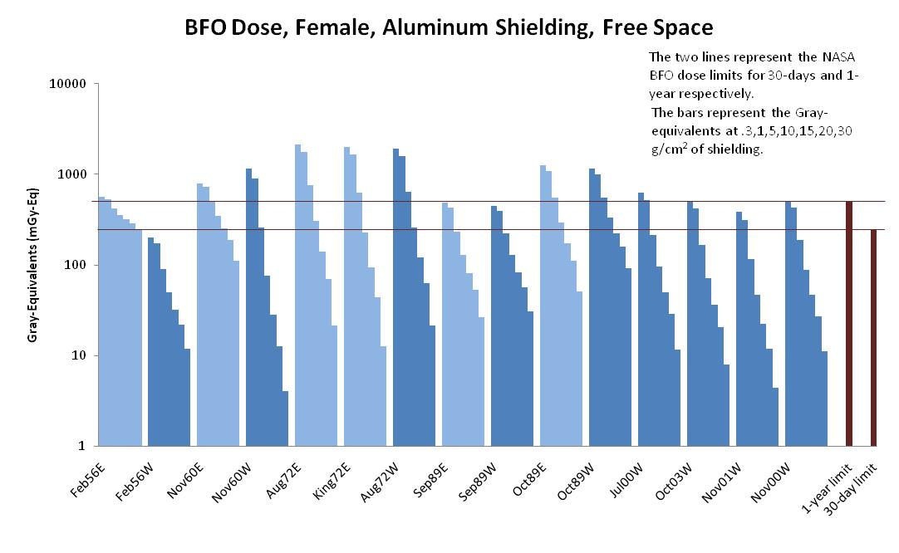
Dose For Several Historical SPEs
Kalki Seksaria, 2011

Slide 37
Shielding Needed to Stay Within
Permissible Exposure Limits
Only the values 0.3, 1, 5, 10, 15, 20, and 30 g/cm² are used, as they are the only ones available in NASA’s ARRBOD model, used to calculate Grey-Equivalent.
Kalki Seksaria, 2011

Slide 38
January 2005 SPE
Characteristics of the January 2005 Solar Particle Event:
  Stressing
  Rapid Onset
  Hard Spectrum
  Low total integral fluence
This chart shows the GOES data for the January 2005 event.

Slide 39
Time to Respond
The time to respond to a hard event with a rapid onset is challenging, as the BFO limit can easily be broken
January 2005 event was used to see how stressing the timeline could be
Since the January 2005 event had a low total integral fluence it is important to see what multiplier is needed to exceed any of the PELs
  The January 2005 event needs to be scaled by a factor of ~20 to match the >30 MeV fluence of the August 1972 event.
EVA length (hours) | 0 | 1 | 2 | 3 | 4 | 5
EVA female BFO dose-equivalent (mSv) | 0 | 18 | 33 | 43 | 50 | 57
Spacecraft female BFO dose-equivalent (mSv) | 30 | 23 | 18 | 15 | 12 | 11
Total female BFO (mSv) (first limit to be broken) | 30 | 41 | 51 | 58 | 63 | 67
Minimum Multiplier to exceed PEL | 8.2 | 6.1 | 4.9 | 4.3 | 4.0 | 3.7
Kalki Seksaria, 2011
Astronauts may have less than 5 hours to get to shelter after event onset.

Slide 40
Mission Risk Balancing
Solar Minimum
Solar Maximum
Few SPEs within one year of solar minimum
More GCR
  About three times higher than at solar maximum
GCR is very difficult to shield against: mission length will be limited by yearly PEL
Higher risk of an SPE
Less GCR
SPEs can be shielded against, but will add to total mission dose, and may disrupt mission operations
An SPE experienced while on EVA can easily exceed the PEL

Slide 41
Key Take-Aways
Radiation is a significant risk to deep space exploration
  Long term cancer risk
  Shorter term, mission limiting health effects
Galactic Cosmic Rays are extremely difficult to shield
  Exposure to GCR will be the mission limiting factor
Solar Partice Events can be shielded but there must be :
  sufficient warning
  adequate shelter, and
  an operations concept that allows time to reach it

Slide 42
Backup Slides

Slide 43
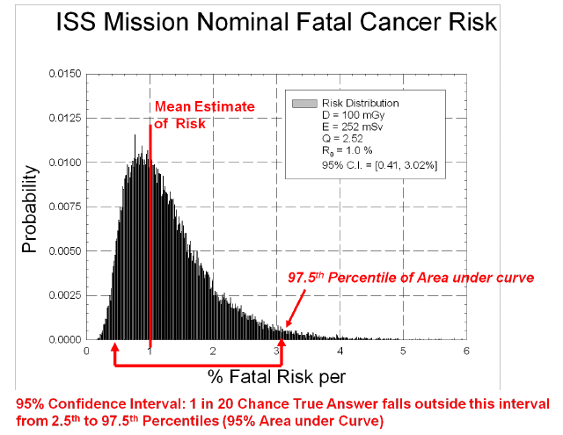
Keck
> Institute for Space Studies

Slide 44
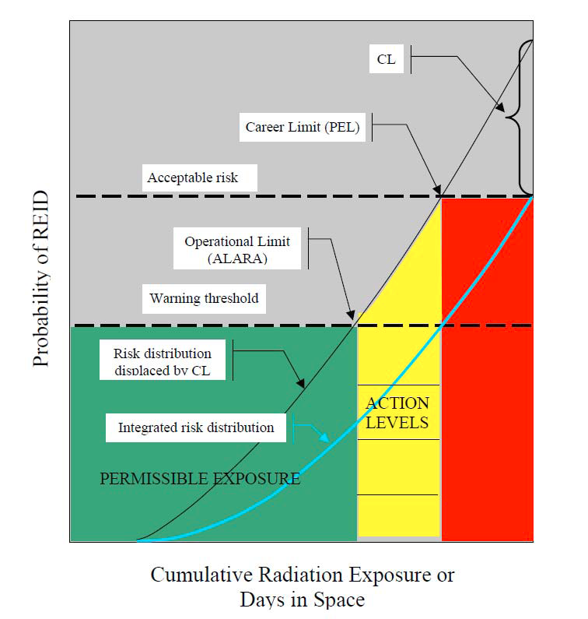
Risk Management with ALARA and Large Uncertainties
Acceptable risk
Warning threshold
After a similar figure from: Schimmerling W., Accepting space radiation risks. Radiat Env Biophys. 2010;49:325-329.

Slide 45
Risk Management with ALARA and Large Uncertainties
Source: Schimmerling W., Accepting space radiation risks. Radiat Env Biophys. 2010;49:325-329.

Slide 46
Sources of Uncertainty
MAJOR
MINOR
Radiation quality effects on biological damage
  Qualitative and quantitative differences of Space Radiation compared to x-rays
Dependence of risk on dose-rates in space
  Biology of DNA repair, cell regulation
Predicting solar events
  Onset, temporal, and size predictions
Extrapolation from experimental data to humans
Individual radiation-sensitivity
  Genetic, dietary and “healthy worker” effects
Data on space environments
    Knowledge of GCR and SPE environments for mission design
Physics of shielding assessments
    Transmission properties of radiation through materials and tissue
Microgravity effects
  Possible alteration in radiation effects due to microgravity or space stressors
Errors in human data
  Statistical, dosimetry or recording inaccuracies

